Slide 1
Bell work week 10
Week of 10/29-11/02

Slide 2
SAT calculator Monday 10/29
$$y=x^{2}−4x+4$$
$$y=4−x$$
If the ordered pair (x,y) satisfies the system of equations above, what is one possible value of x?

Slide 3
SAT NC Tuesday 10/30
The function f is defined by $f\left(x\right)=\left(x+3\right)\left(x+1\right).$
The graph of f in the xy-plane is a parabola. Which of the following intervals contains the x- coordinate of the vertex of the graph of f?
$−4<x<−3$
$−3<x<1$
$1<x<3$
$3<x<4$

Slide 4
SAT NC Wednesday 10/31
What are the solutions to $3x^{2}+12x+6=0?$
$x=−2$± $\sqrt{2}$
$x=−2$ ± $\frac{\sqrt{30}}{3}$
$x=−6$ ±$\sqrt{2}$
$x=−6$± 6$\sqrt{2}$

Slide 5
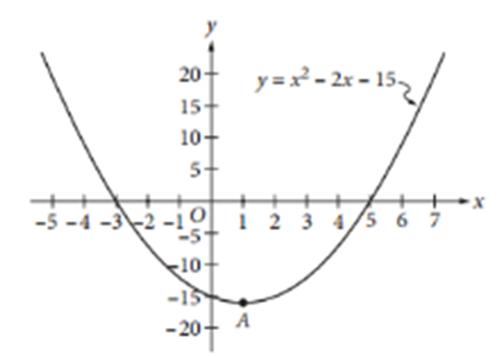
SAT NC Thursday 11/01
Which of the following is an equivalent form of the equation of the graph shown in the xy-plane above, from which the coordinates of the vertex A can be identified as constants in the equation?
$y=\left(x+3\right)\left(x−5\right)$
$y=\left(x−3\right)\left(x+5\right)$
$y=x\left(x−2\right)−15$
$y={(x−1)}^{2}−16$

Slide 6
Friday 11/02
SAT Quiz 2

