Slide 1
Bell work week 8
Week of 10/15-10/19

Slide 2
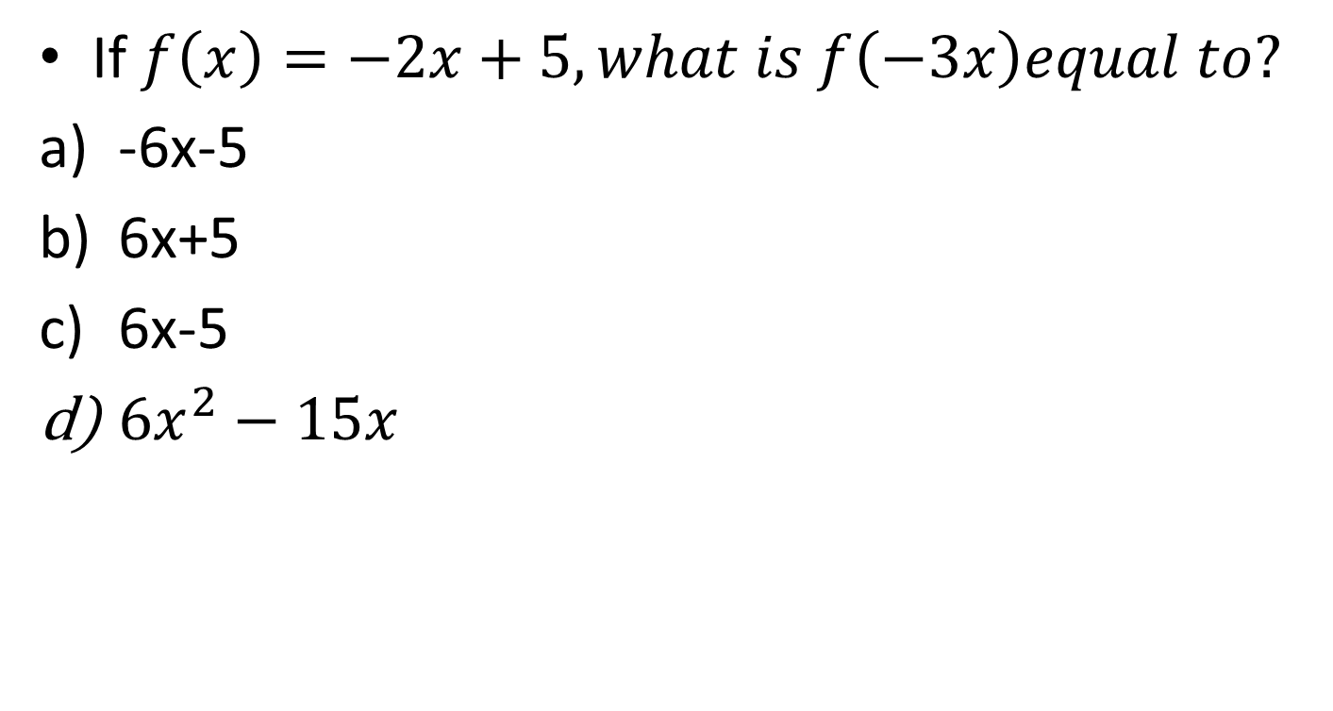
SAT NC Monday 10/15
If $f\left(x\right)=−2x+5, what is f\left(−3x\right)equal to?$
-6x-5
6x+5
6x-5
${6x}^{2}−15x$

Slide 3
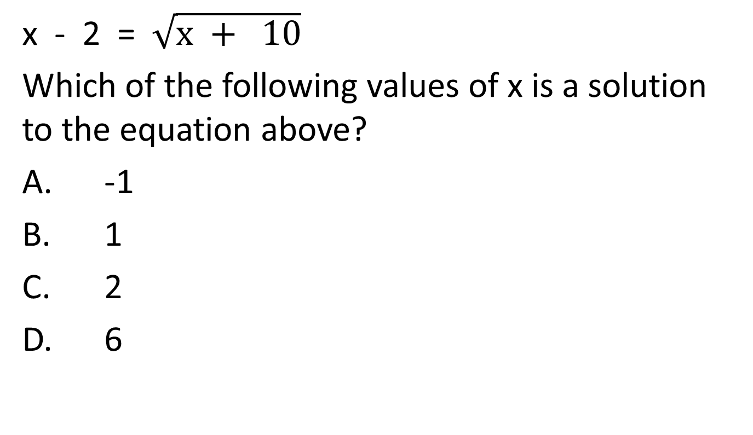
x - 2 = $\sqrt{x + 10}$
Which of the following values of x is a solution to the equation above?
A. -1
B. 1
C. 2
D. 6

