Slide 1
Bell Work week 7
Week of 10/08-10/12

Slide 2
Monday 10/08
On his first 4 history tests, Pete earned scores of 70, 74, 82, and 83. In order to have an average of at least 80, what is the minimum score that Pete must earn on the next test?

Slide 3
Tuesday 10/09
Terri calc prob 2

Slide 4
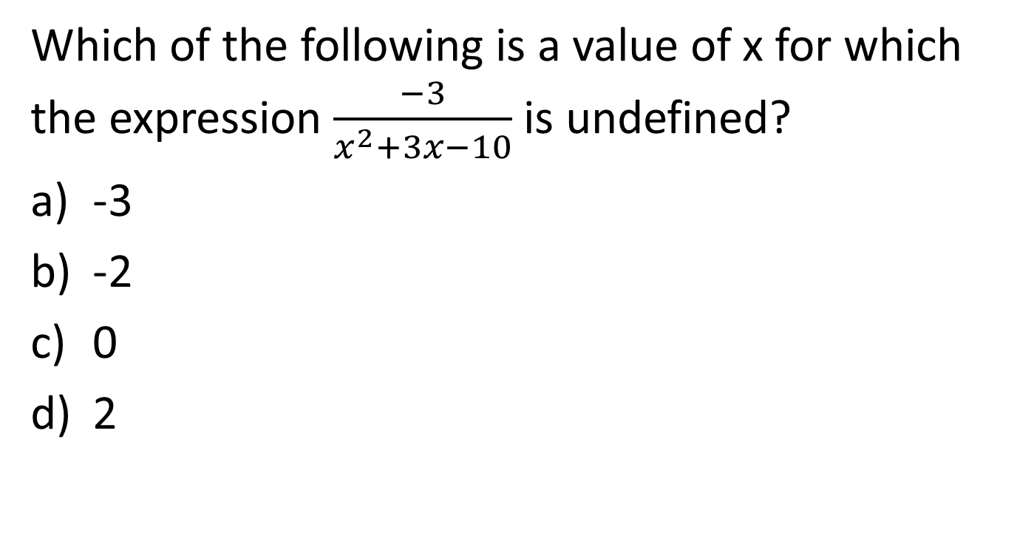
SAT NC Wednesday 10/10
Which of the following is a value of x for which the expression $\frac{−3}{x^{2}+3x−10}$ is undefined?
-3
-2
0
2

Slide 5
SAT NC Thursday 10/11
A function f satisfies f(2)=3 and f(3)=5. A function g satisfies g(3)=2 and g(5)=6. What is the value of f(g(3))?
2
3
5
6

Slide 6
Friday 10/12
Half Day/ Pep Rally

