Slide 1
Bell work week 6 Precalc
Week of 10/01-10/05

Slide 2
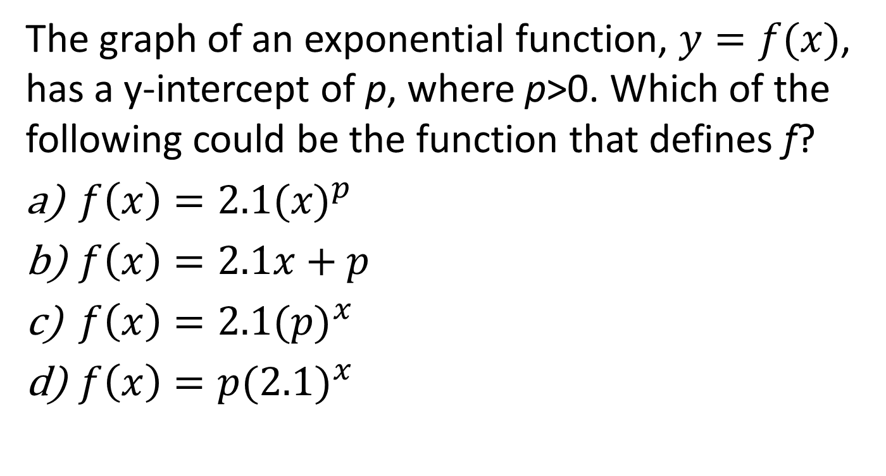
SAT Calc allowed
Bell work Monday 10/01
The graph of an exponential function, $y=f(x)$, has a y-intercept of p, where p>0. Which of the following could be the function that defines f?
${f\left(x\right)=2.1(x)}^{p}$
$f\left(x\right)=2.1x+p$
${f\left(x\right)=2.1(p)}^{x}$
${f\left(x\right)=p(2.1)}^{x}$

Slide 3
SAT calc allowed
Tuesday 10/02
Last month, Eve worked 180 hours. Her friend, Kara, suggested that this month Eve should work 15% fewer hours than she did last month. If Eve takes Kara’s advice, how many hours will Eve work this month?
27
153
162
165

Slide 4
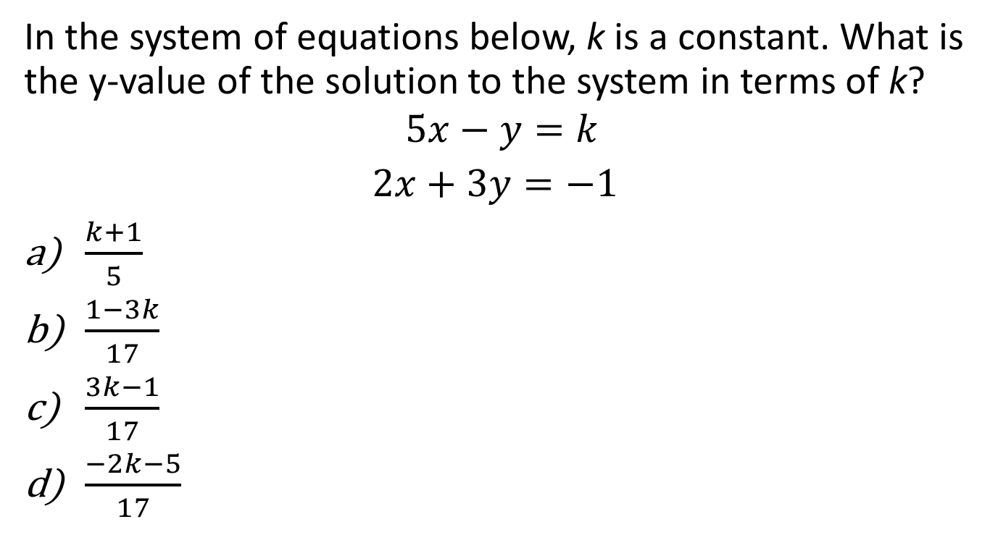
SAT calc allowed
Wednesday 10/03
In the system of equations below, k is a constant. What is the y-value of the solution to the system in terms of k?
$$5x−y=k$$
$2x+3y=−1$
$\frac{k+1}{5}$
$\frac{1−3k}{17}$
$\frac{3k−1}{17}$
$\frac{−2k−5}{17}$

Slide 5
SAT Calc Allowed
Thursday 10/04
On his first 4 history tests, Pete earned scores of 70, 74, 82, and 83. In order to have an average of at least 80, what is the minimum score that Pete must earn on the next test?

Slide 6
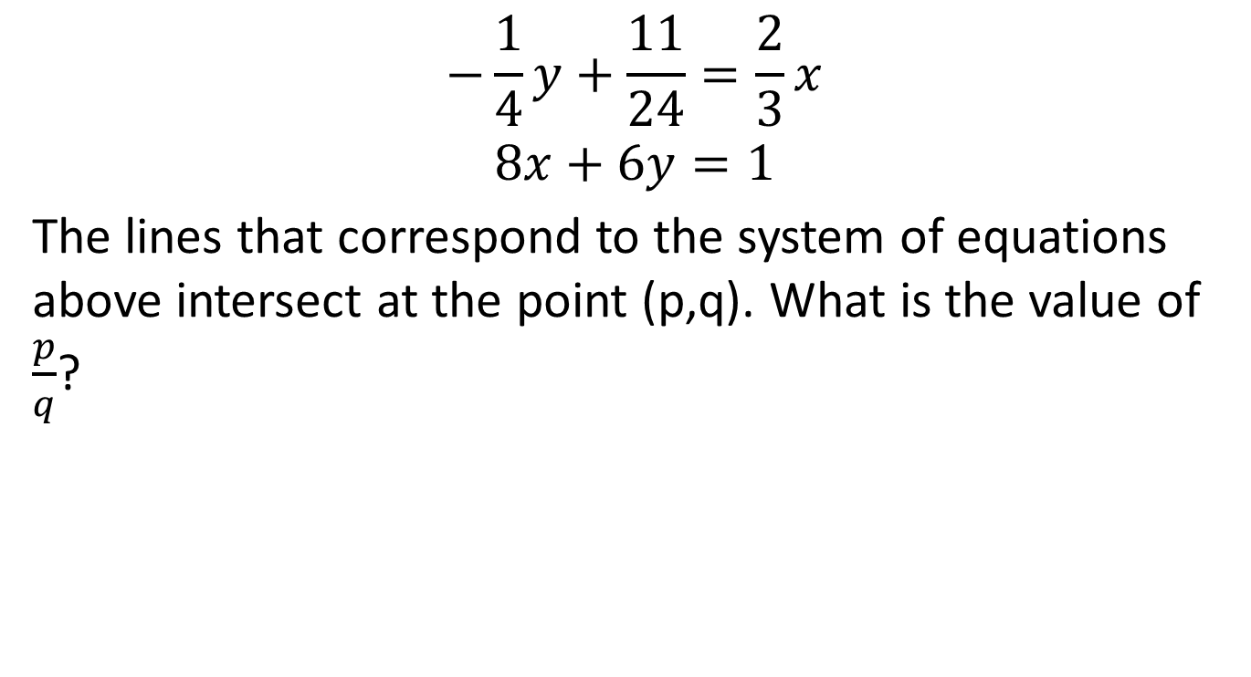
SAT Calc Allowed
Bell Work Friday 10/05
$$\begin{matrix}−\frac{1}{4}y+\frac{11}{24}=\frac{2}{3}x \\ 8x+6y=1\end{matrix}$$
The lines that correspond to the system of equations above intersect at the point (p,q). What is the value of $\frac{p}{q}$?

