Slide 1
Chapter 2: Polynomial , Power, and Rational Functions
Section 2.1

Slide 2
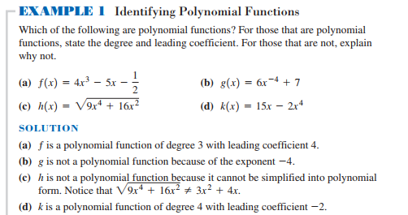
Section 2.1: Linear and Quadratic Functions Modeling
Read example 1 p 158

Slide 3
Table p159
Linear and Quadratic Functions are also called polynomial Functions

Slide 4
Quadratic Functions
Standard form ${ax}^{2}+bx+c$
Vertex form ${a(x−h)}^{2}+k$
Any Quadratic function can be written in vertex form

Slide 5
Find the vertex of the following functions
${y=2(x−4)}^{2}+7$
${y=2(x+4)}^{2}+7$
${y=2(x+4)}^{2}+7$
${y=2(x−4)}^{2}−7$

Slide 6
Converting to vertex form
${y=2x}^{2}−3x+4$
h=$\frac{−b}{2a}$
To find K plug in h for x in the standard form, k is the y

Slide 7
Write the following function in vertex form
$f\left(x\right)={6x−3x}^{2}−5$

Slide 8
To describe the graph of a Quadratic Function
Vertex (h,K)
Axis of the parabola (axis of symmetry) x=h
Parabola opens upward (a>0) parabola opens downward (a<0)
Initial value (y intercept) : f(0)=c
X intercepts (quadratic formula)

Slide 9
Homework
Page 169# 23-32

