Slide 1
$f\left(x\right)=\frac{(x+2)(x−3)}{(x+2)(x−5)}$
An asymptote is a line that a graph approaches without touching
A vertical asymptote occurs in a rational function at any value of x for which the denominator is equal to 0, but for which the numerator is not equal to 0.
When a value of x sets both the denominator and the numerator of a rational function equal to 0, there is a hole in the graph; that is, a single point at which the function has no value

Slide 2
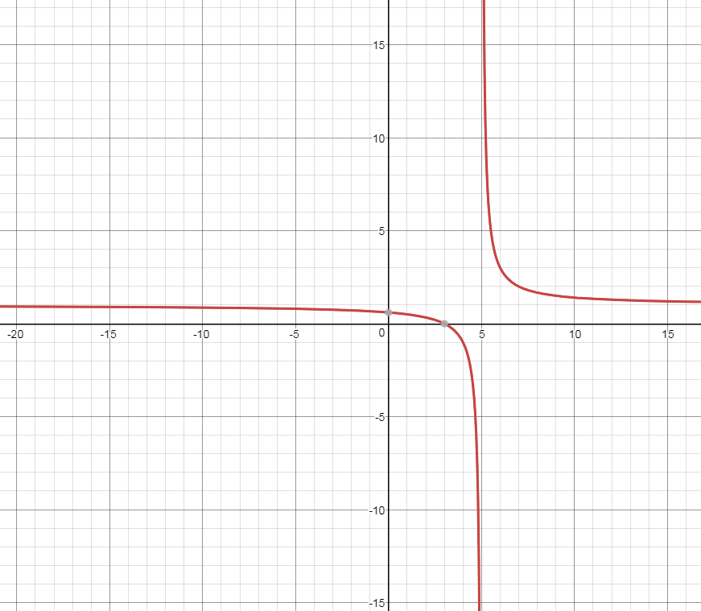
$$f\left(x\right)=\frac{(x+2)(x−3)}{(x+2)(x−5)}$$
Type of function
Restrictions?
Graph it, what do you notice?

Slide 3
Examples: Name the vertical asymptotes and holes in the graphs of the following equations:
f (x) = $\frac{(x−2)(x+4)}{(x−3)(x+3)(x+4)}$
f (x) = $\frac{x^{2}(x+2)}{x^{3}{(x−2)}^{2}}$
f (x) = $\frac{{(x−1)}^{2}}{(x+1)(2x−3)(\frac{1}{2}x+6)}$

