Slide 1
Bell work week 5 Precalc
Week of 10/02-10/06

Slide 2
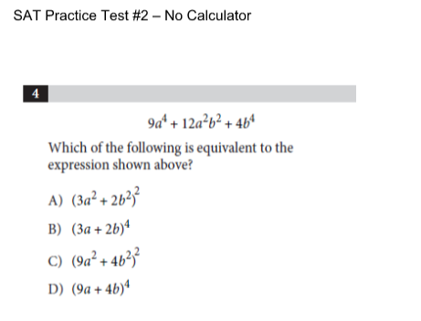
Monday 10/02/2017

