Slide 1
Precalculus Notes
Section 1.2 p 80---98

Slide 2
Wednesday 09/22/2017
SAT

Slide 3
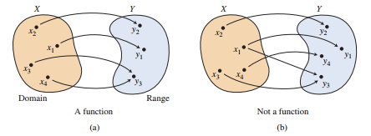
Functions
A function from a set D to a set R is a rule that assigns to every element in D a UNIQUE element in R.
The set D of all input values is the domain of the function
The set R of all output values is the range of the function
f(2)=8
f(2)=4 Not a function
Reminder Vertical Line Test
The value of y depends on x: y is the dependent variable and x is the independent variable

Slide 4
Reminder Vertical Line Test
The value of y depends on x: y is the dependent variable and x is the independent variable

Slide 5
The Domain of some Basic Functions
The machine analogy
Polynomials
${3x}^{2}+4x$
${2x}^{3}+3x^{2}+2x−7$
$Volume of a sphere : v\left(r\right)= \frac{4}{3}$∏$r^{3}$ Domain?
The domain should fit the situation
Always Think about restrictions

Slide 6
Find the domain of each of the following functions
$f\left(x\right)=\left|x+2\right|$
$f\left(x\right)=\sqrt{x}$
$f\left(x\right)=\sqrt{x+2}$
$f\left(x\right)=\frac{2}{x}$
$f\left(x\right)=\frac{2}{x+3}$

Slide 7
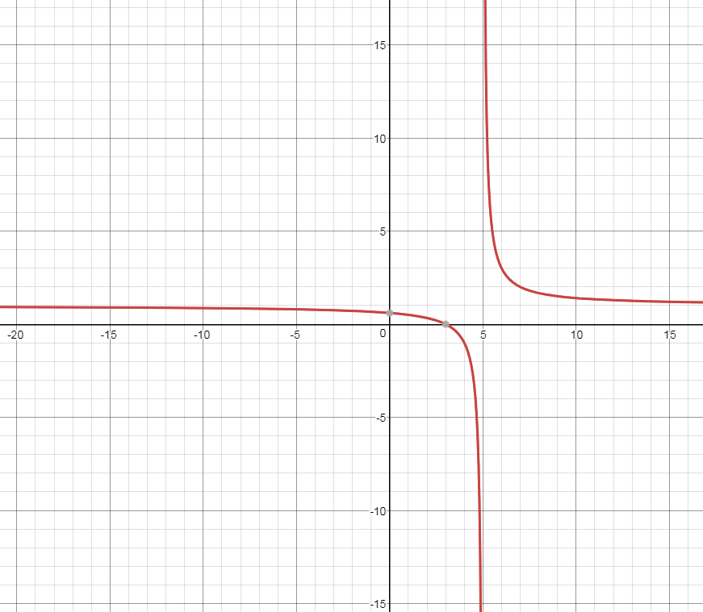
$$f\left(x\right)=\frac{(x+2)(x−3)}{(x+2)(x−5)}$$
Type of function
Restrictions?
Graph it, what do you notice?

Slide 8
Example 3 Page 82
$f\left(x\right)=\sqrt{x+3}$
$g\left(x\right)=\frac{\sqrt{x}}{x−5}$
$A\left(s\right)=\frac{\sqrt{3}}{4}s^{2}$ where A9s) is the area of an equilateral triangle and s is the length of each side
Now let’s graph all 3 and check the domain

Slide 9
Continuous vs Discontinuous
A function is continuous at a point, if the graph does not come apart at that point

Slide 10
Find the domain of the following functions
$f\left(x\right)=\frac{x+3}{x−2}$
$f\left(x\right)=\left(x+3\right)\left(x−2\right)$
$f\left(x\right)=\frac{x^{2}−4}{x−2}$

Slide 12
Homework
page 95#9-16
Page 95#21-24

