Slide 1
Precalculus
Section P2 & P4

Slide 2
Equations of circles
A circle is the set of points in a plane at a fixed distance (radius) from a fixed point (center).
The standard form equation of a circle is:${(x−r)}^{2}+{(y−k)}^{2}=r^{2}$
Center (r,k) radius r
Example: ${(x−2)}^{2}+{(y−3)}^{2}=25$
${(x+2)}^{2}+{(y+3)}^{2}=25$
${(x+5)}^{2}+{(y−7)}^{2}=16$

Slide 3
Write the equation of a circle with center (4,7) and radius 8
Application : p19# 42,44,47

Slide 4
Section P4 page 28-35
Find the slope of the line through the two points :
(-2,3) and (5,7)
Page 28 example 1
(-1,2) and (4,-2)
(1,1) and (3,4)

Slide 5
Point slope form
The point slope form of an equation of a line is:
y-y1=m(x-x1)
Find an equation of the line that passes through the point (-3,-4) and has slope 2. write the equation in point slope form.

Slide 6
Parallel and perpendicular lines
2 parallel lines have the same slope.
Example: y=2x+7 and y=2x-6
a)Find an equation of a line parallel to y=2x+5 and passing through (2,3)

Slide 7
Perpendicular lines
The slopes of 2 perpendicular lines are opposite reciprocal:
m1= - $\frac{1}{m2}$
Example: y= -$\frac{2}{3}x+7 and y=\frac{3}{2}x−6$
Find the equation of a line perpendicular to 2x+5 and passing through (2,3)

Slide 8
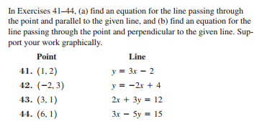
Homework
Page 19 41,43,45,46,47,48
Page 36: 3 to 6, 11 through 14 and page 37: 41 through 44.

Slide 9
Thursday 09/14/2017
Have your bell work sheet out from yesterday and start Wednesday bell work.
Remember to show your work.

