Slide 1
Pre calculus notes
Section P7
Page 54-59

Slide 2
Linear Inequalities Review
Solve the following inequalities:
X+4>0
2x+3<0
-x+5>0

Slide 3
Solving Quadratic Inequalities
Section P7: p54-59
Graphically
$$x^{2}−x−12>0$$
Find the zeros (by factoring)
Find the parts of the parabola that satisfy the inequality (either above the x axis or below the x axis)
Find the corresponding x values

Slide 4
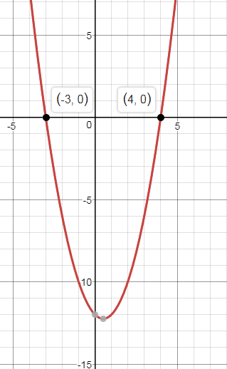
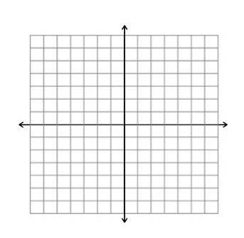
Example 3 p55
$$x^{2}−x−12>0$$
$x^{2}−x−12=0$
(x+3)(x-4)=0

Slide 5
Solve the Quadratic Inequality Algebraically
$$x^{2}−x−12>0$$
Factor it and find the zeros
Draw a number line (or table) and locate the zeros
Fill out the signs for each factor, then find the sign of the whole expression
Choose the correct interval

Slide 6
$$x^{2}−x−12>0$$
(x-4)(x+3)

Slide 7
Example 4 p55
$${2x}^{2}+3x≤20$$
Solve the above inequality graphically and algebracailly
Graphically

Slide 8
Algebraically
${2x}^{2}+3x≤20$

Slide 9
Example 6 page 56
$x^{2}+2x+2<0$

Slide 10
Page 58 #15
$x^{3}−x≥0$

Slide 11
Page 58#13: Solve algebraically
${2−5x−3x}^{2}<$0

Slide 12
Homework
Page 58#9-16
Page 58#17-26 (use a calculator)

