Slide 1
Pre-calculus Notes
Chapter P

Slide 2
Real Numbers
A real number is any number that can be written as a decimal
The set of real numbers include many subsets:
Natural
Whole numbers
Integers
Rational Numbers
Irrational Numbers

Slide 3
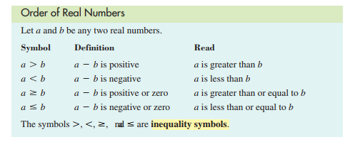
The set of real numbers is ordered.
Inequalities will be used to compare real numbers .
Inequality symbols are:

Slide 4
Graph of inequalities
Describe and graph the interval of real numbers for the following inequalities:
a) x<3
b) -1<x ≤ 4
Try it out p9#5,6
X ≤ 2
-2≤x<5

Slide 5
Write an interval of real numbers using an inequality and draw its graph
a) The real numbers between -4 and -0.5
b) The real numbers greater than or equal to 0

Slide 6
Try it out Page 9 # 15-16
15) x is between -1 and 2
16) X is greater than or equal to 5

Slide 7
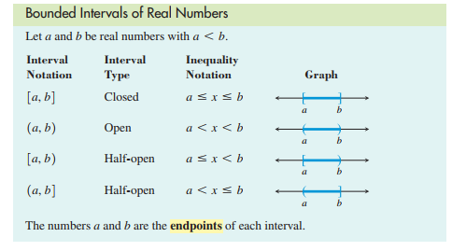
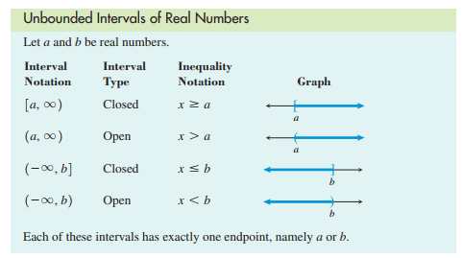
Bounded vs Unbounded Intervals

Slide 8
Converting between Intervals and Inequalities
[-6,3)
(-∞,-1)
-2 ≤x< ≤3

Slide 9
Try it out
Page 10#29
(-3,4]
Homework page 9: 7 through 14, 17 through 28
Page 10: 30,31,32

