Slide 1
Revision for Quiz 2
EL1B

Slide 2
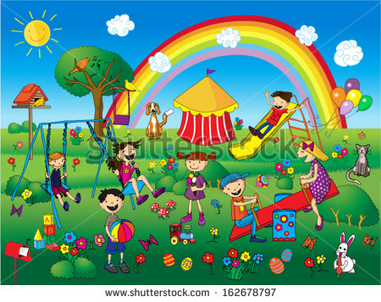
Yes/No Question
-Review worksheets
1-Are the children happy?
2-Do you like rainbows?
3-Does the girl have ice cream?
4-Is the bird on the tree?
5-Is the cat eating a carrot?

Slide 3
‘S and S’
Add s or ‘s where needed.
1- Haidar dog played with the ball.
2- The little girl dress was stained.
3- The men football team scored a goal.
4-The students books were open.
5-The birds beaks are yellow.

Slide 4
Homophones
1- Give 3 sentences using their/they’re/there.
2- Give three sentences using
know/no

Slide 5
Homographs
Write three examples of homographs:

Slide 6
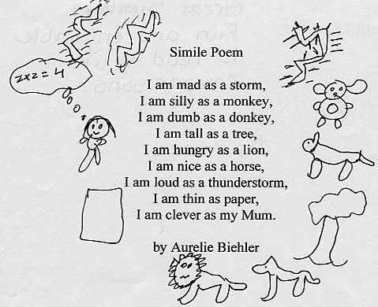
Similes
1-Identify all the similes
2-Explain what the poem is about.
3-Why is the author using similes?

Slide 7
Compound Word
Add to the lists:
In the house At School
Bedroom Bookcase
Bathroom Backpack
Armchair Smart Board

