Slide 1


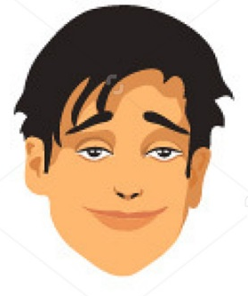

5
4
Social Story
for Using
My 5 Point Scale
3
2
1

Slide 2
5
4
Stress, anxiety, frustration and anger are emotions
that can be difficult to understand and control. It helps to
learn more about them and myself.
3
2
1

Slide 3
5
4
Sometimes I feel relaxed, calm and
in control of my emotions and behavior. When this happens
I am at a 1
and can
___________________.
3
2
1

Slide 4
5
4
When I am at 1
I feel good
and others
want to be around me.
3
2
1

Slide 5
Sometimes I feel
a little worried,
tired, nervous,
uneasy or anxious. When this happens
I am at a 2 and can __________________
to feel better
and return to a 1.
5
4
3
2
1

Slide 6
5
When I am at 2
and use my strategies,
I start to feel better
and others start to feel
more comfortable around me.
4
3
2
1

Slide 7
5
Sometimes I feel frustrated, tense, annoyed and
am struggling
to stay in control.
When this happens
I am at a 3 and can _________________ to feel better and return to a 2 or 1.
4
3
2
1

Slide 8
When I am at 3
and use my strategies,
I start to feel better
and others start to feel
more comfortable around me.
5
4
3
2
1

Slide 9
Sometimes I feel
so upset that
I have negative thoughts
and feel that
I am starting to lose it. When this happens
I am at a 4.
Others can help me
make better choices
by prompting me to ____________________ so I can feel better
and return to a 3, 2 or 1.
5
4
3
2
1

Slide 10
When I am at 4 and use my strategies,
I start to calm down
and others
begin to feel
safe around me.
5
4
3
2
1

Slide 11
5
Sometimes
I totally lose
control of
what I do or say. When this happens
I am at a 5
and people around me
do not feel
comfortable or safe. Others can
help me calm down
by prompting me to __________________ so I can feel better and return to a 4, 3, 2 or 1.
4
3
2
1

Slide 12
When I am at 5 and use my strategies,
I start to regain control of myself and
others start to
interact with me again.
5
4
3
2
1

Slide 13
Most people feel stress, anxiety, frustration or anger from time to time and this is okay.
It is important
to learn ways
to feel better and calm down.
I will try
to use my strategies to stay in control
so that people
will be comfortable around me.
5
4
3
2
1

Slide 14
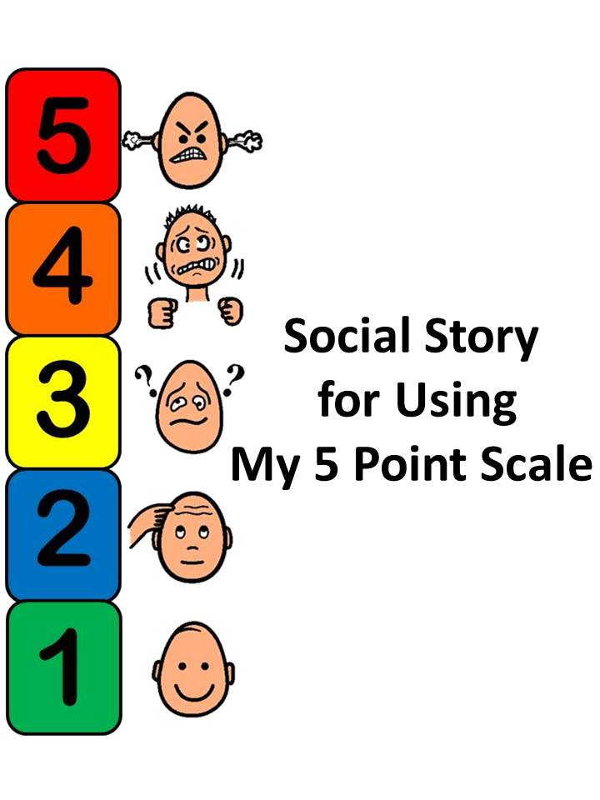
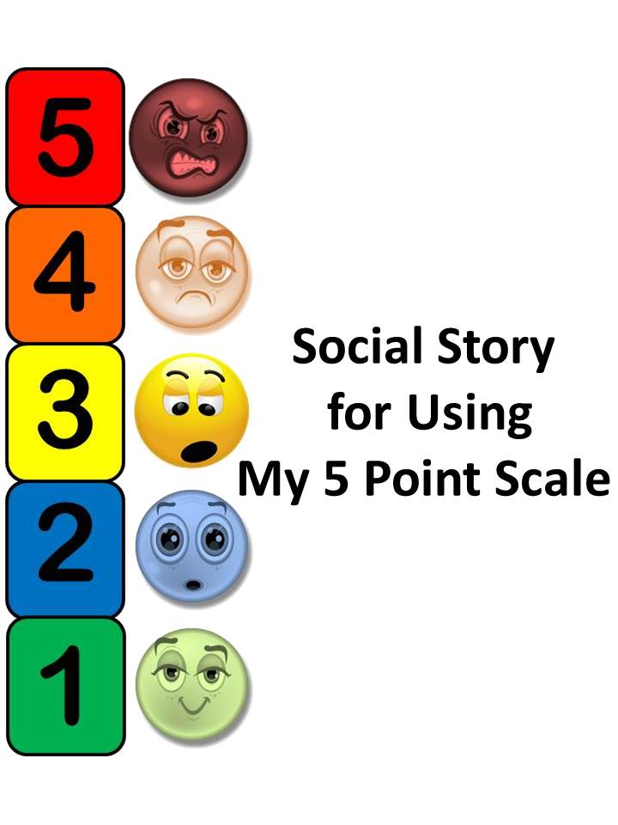
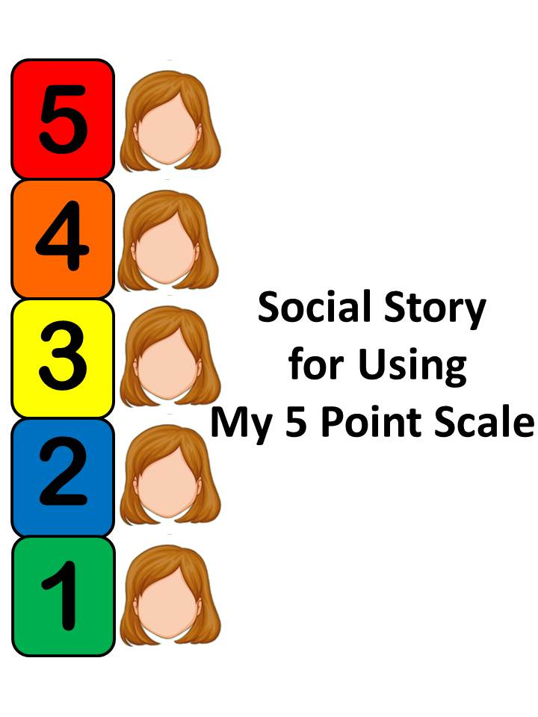
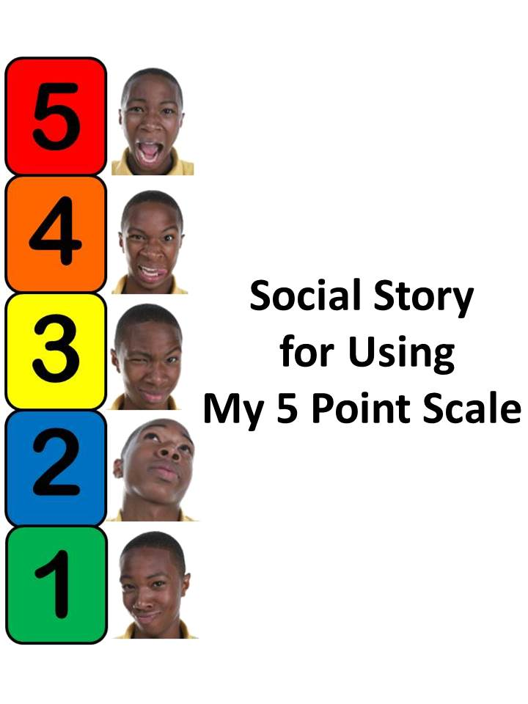
The following pages offer
36 sets of diverse characters that can be “cut and pasted”
for use to individualize the
Social Story for
Using My 5 Point Scale.

Slide 15
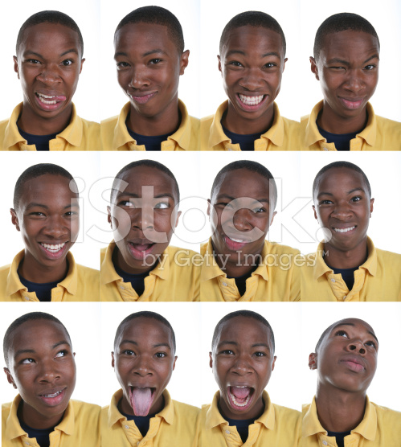
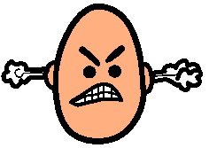





Slide 16
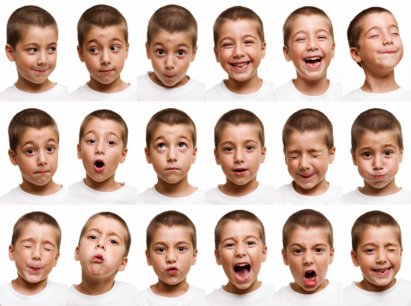
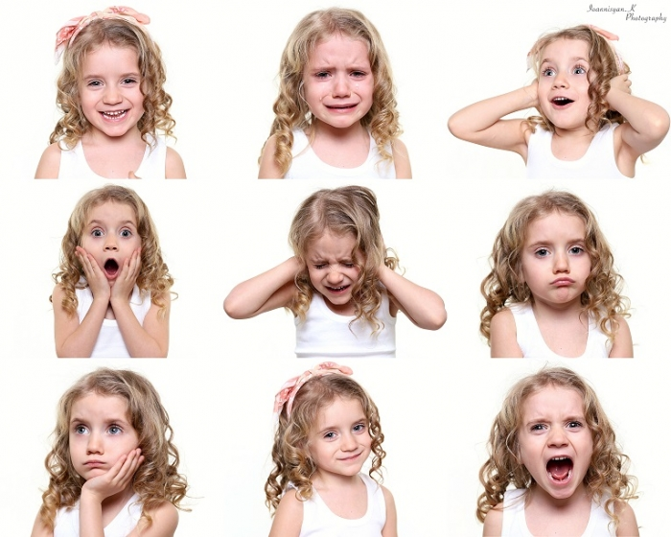
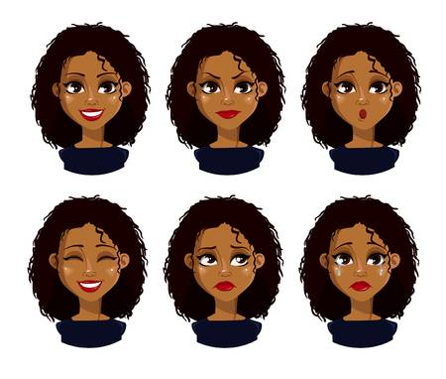

Slide 17
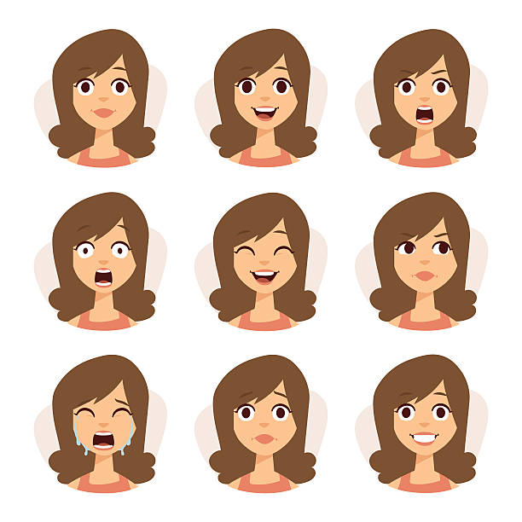
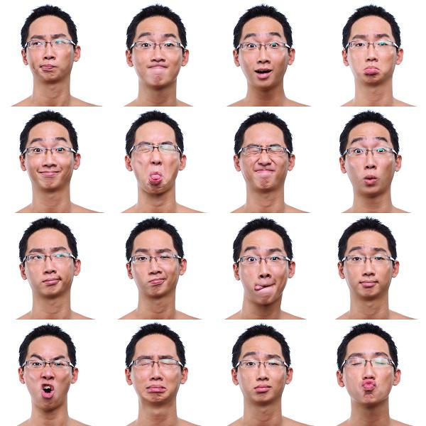
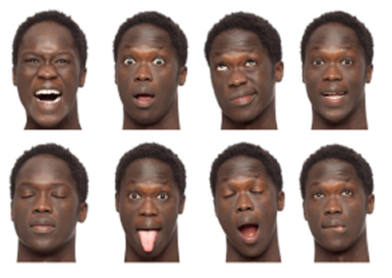
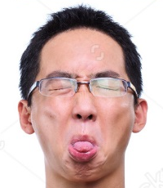

Slide 18
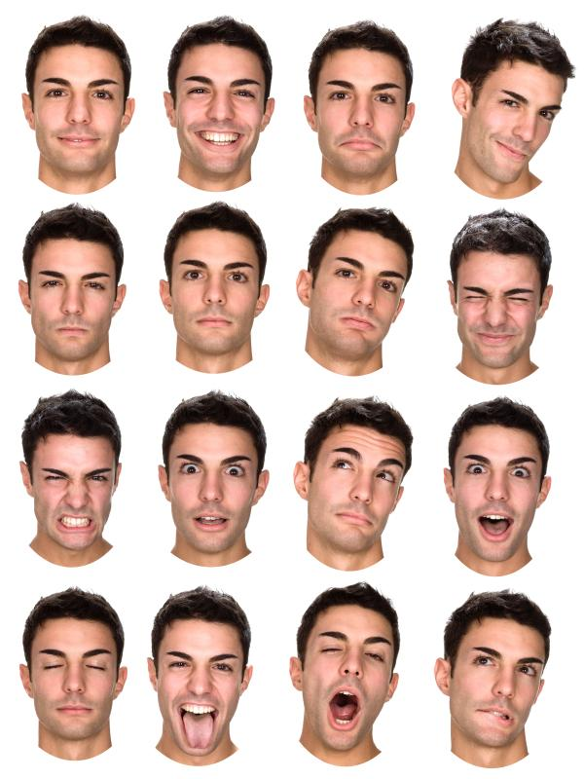







Slide 19
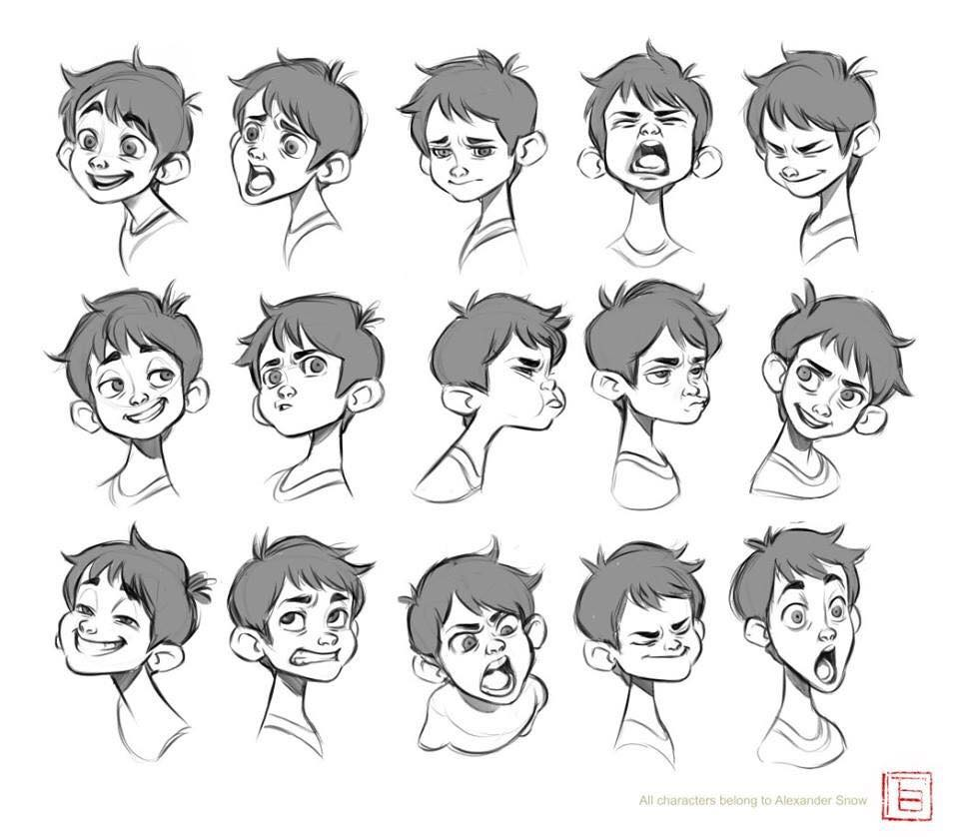
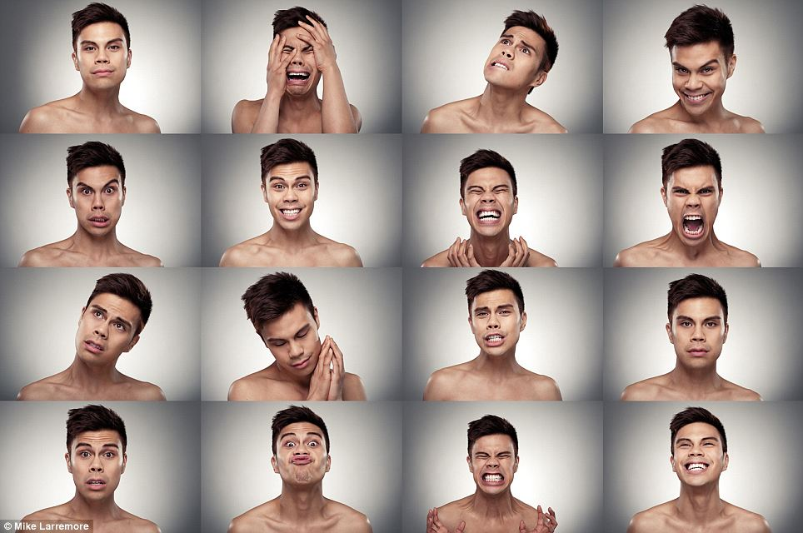
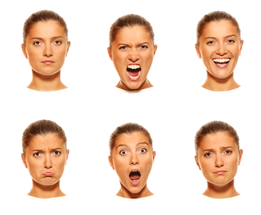

Slide 20
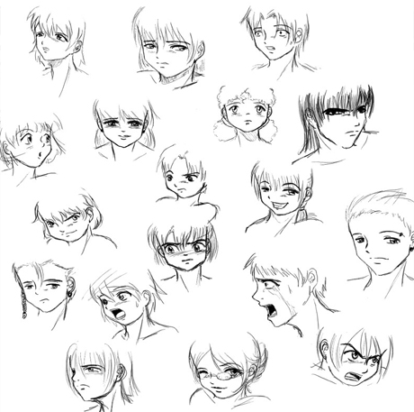
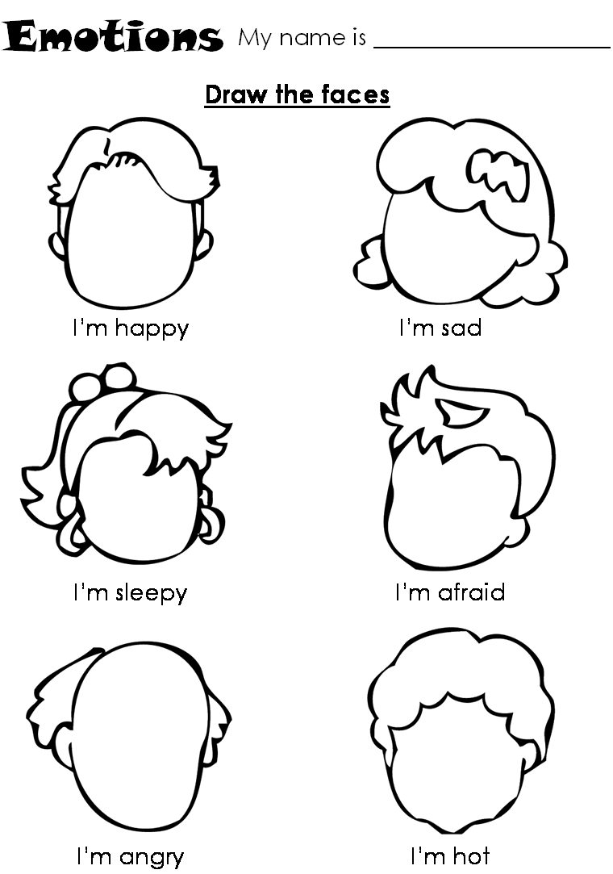

Slide 21
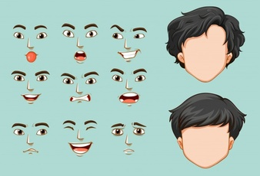



Slide 22
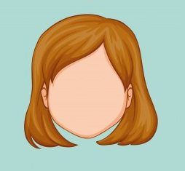

Slide 23


Slide 25


Slide 26
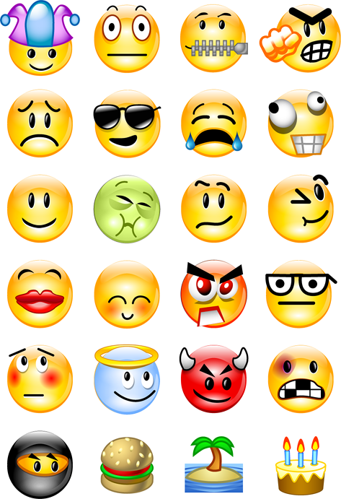







Slide 27

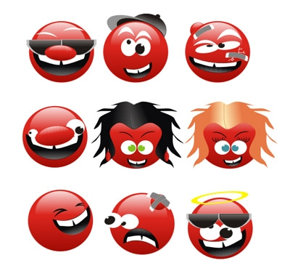


Slide 28




Slide 30
The following pages offer
visual supports for
36 interventions to consider, that can be “cut and pasted”
into the
Social Story for
Using My 5 Point Scale.

Slide 31

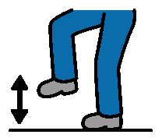
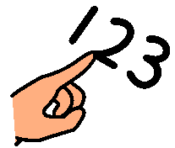








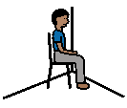
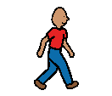
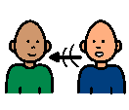

Ask to Take a Break
Stomp My Feet
Count to 10
Start Over
Think of a Solution
Hug a Pillow
Take a Break
Find a Quiet Place
Ask for Help
Time Alone
Listen to Music
Time Alone
Ask to Take a Walk
Talk to a Friend
Talk to Someone You Trust

Slide 32
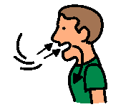
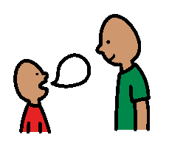



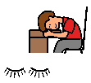


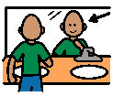

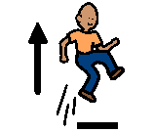
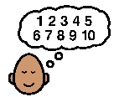




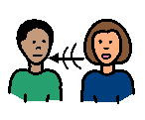
Take Deep Breaths
Use My Words
Stretching Exercises
Close Eyes/
Head Down
Squeeze a Ball
Take 3 Deep Breaths
Yoga
Think About Something You Like
Positive Self Talk
Jump 5 Times
Count to 10
Stop Talking
Wall Push Ups
Jump on Trampoline
Talk to an Adult

Slide 33


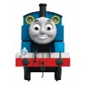


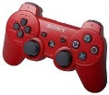
Listen to Music
Think About Something You Like
Ask for Help
Take 3 Deep Breaths
Think About Something You Like
Enjoy the Peace

Slide 34
The following pages offer
some other visual supports
that can be “cut and pasted”
into the
Social Story for
Using My 5 Point Scale.

Slide 35

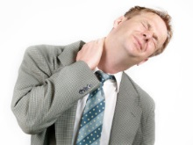


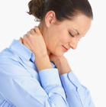
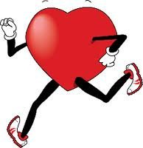


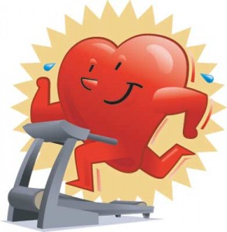
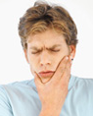
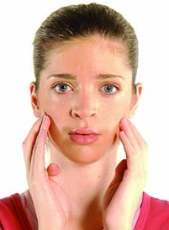
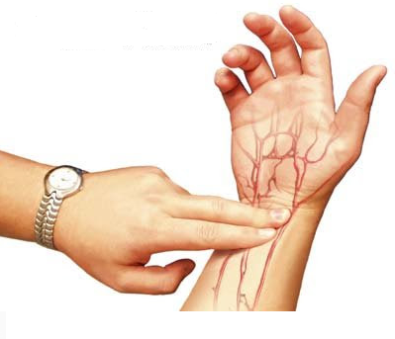
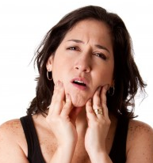
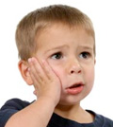
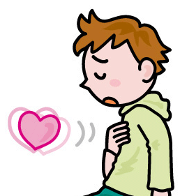
Fist Clenched
Muscles Tight
Heart Pounding
Fists Clenched
Neck Tight
“Heart Racing”
Fist Clenched
Neck Tight
“Heart Racing”
Jaw Clenched
Jaw Tight
Heart Beating Fast
Jaw Clenched
Jaw Tight
Heart Pounding

Slide 36

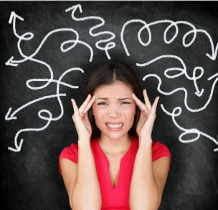

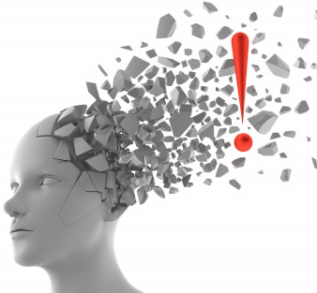











Head Pounding
Thoughts Racing
Stomach Churning
Head Exploding
Mind Racing
Stomach Churning
Head Exploding
Thoughts Racing
Stomach Churning
Head Exploding
Mind Racing
Stomach Churning
Headache
Thoughts Racing
“Knot in Stomach”

Slide 37
















Slide 38
The following pages offer
more space if needed to “cut and paste” visual supports for
36 interventions to consider.

Slide 39
5
Sometimes I feel relaxed, calm and
in control of my emotions and behavior. When this happens
I am at a 1
and can
___________________.
4
3
2
enjoy the peace
1

Slide 40
Sometimes I feel
a little worried,
tired, nervous,
uneasy or anxious. When this happens
I am at a 2 and can
__________________
to feel better
and return to a 1.
5
4
3
use positive self talk
2
1

Slide 41
Sometimes I feel frustrated, tense, annoyed and
am struggling
to stay in control.
When this happens
I am at a 3 and can
_________________ to feel better and return to a 2 or 1.
5
4
3
2
1
ask for help

Slide 42
Sometimes I feel
so upset that
I have negative thoughts
and feel that
I am starting to lose it. When this happens
I am at a 4.
Others can help me
make better choices
by prompting me to
____________________ so I can feel better
and return to a 3, 2 or 1.
5
4
3
2
1
stop talking

Slide 43
Sometimes
I totally lose
control of
what I do or say. When this happens
I am at a 5
and people around me
do not feel
comfortable or safe. Others can
help me calm down
by prompting me to
__________________ so I can feel better and return to a 4, 3, 2 or 1.
5
4
3
2
1
find a quiet place

