Slide 1
The Greenhouse Effect
It is necessary and natural

Slide 2
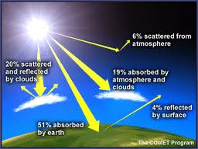

Slide 3
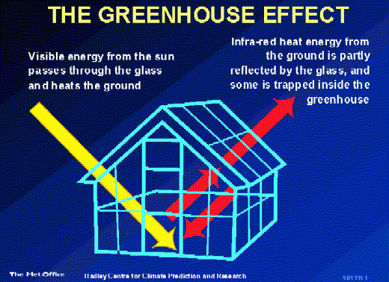

Slide 4
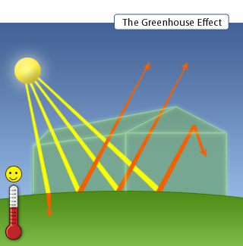

Slide 5
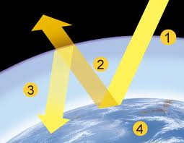

Slide 6
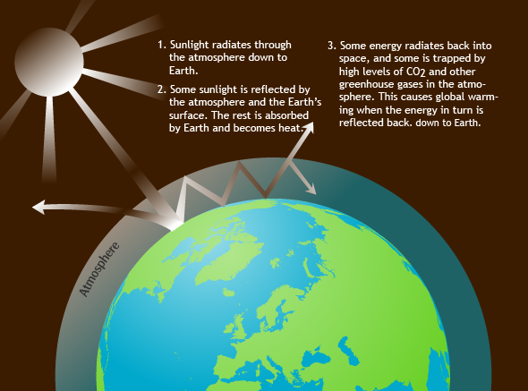

Slide 7
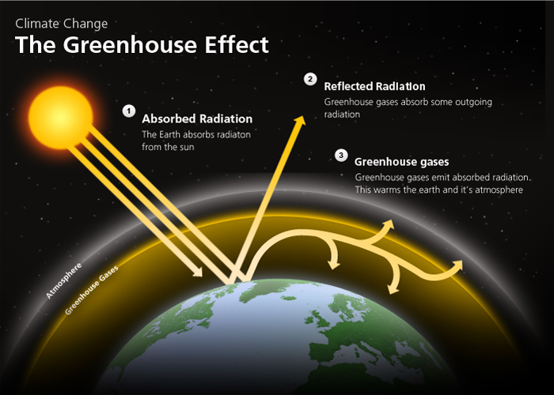

Slide 8
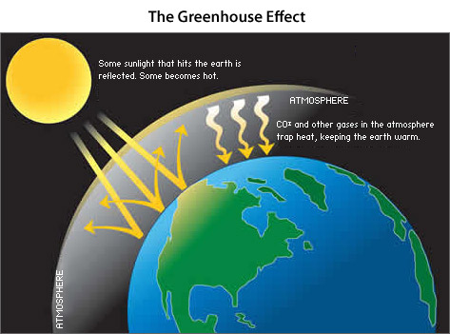

Slide 9
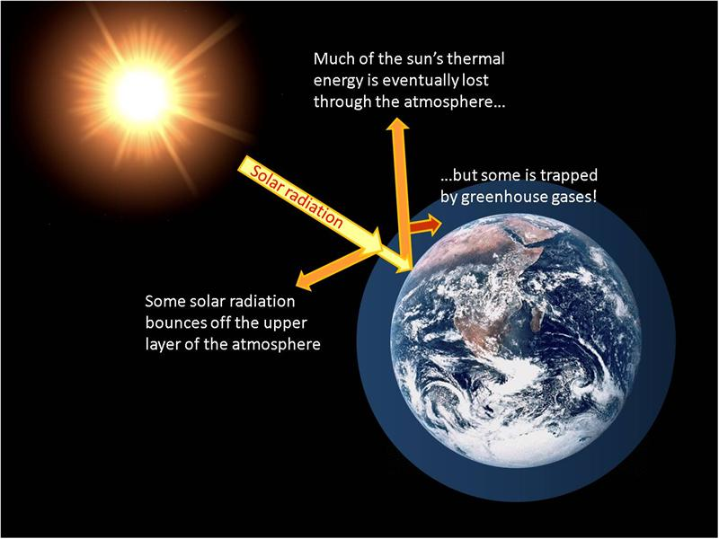

Slide 10
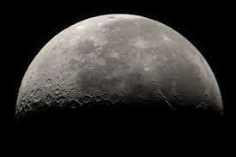
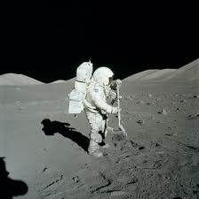
If we did not have an atmosphere… we would not have a greenhouse effect.
The temperatures on Earth would be Extremely hot during the day and extremely cold during the night…like on the Moon or Mercury.

Slide 11
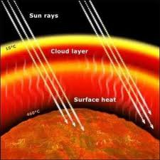
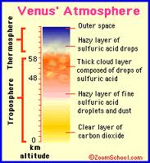
If our atmosphere was really thick… … our greenhouse effect would be too extreme like on Venus.

Slide 12
Earth’s atmosphere is just right for us to have a climate that will support life as we know it.
The fear is if we change our atmosphere, we may change the perfect balance of our atmosphere and change our climate.

Slide 13
