Slide 1
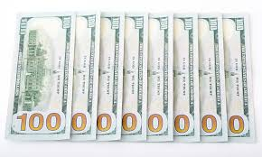
The Billionaires’ Club
By Mr. Biggar

Slide 2
CEO and founder of Facebook

Slide 3
Mark Zuckerberg
Born in White Plains, New York (U.S.A.)
Grew up in New Hampshire
Born on May 14, 1984 (34 years old)
Married with two children

Slide 4
Net worth: $ 73.4 Billion
Got rich from starting Facebook!
Self-made
Went to Harvard University in Cambridge, Massachusetts
Ranking: 5th richest in the world

Slide 5
Fun Facts
“The Social Network” movie is based on Mark creating “the facebook”
Never graduated from Harvard!
Movie is based off a book called “The Accidental Billionaires”

Slide 6
His parents hired a private computer tutor for him when he was a child
Has donated over $100 million to school systems
Close friends with Sean Parker, co-founder of Napster

