Slide 1
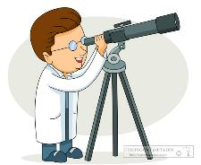
Lindbergh Elementary Science Fair Boot Camp 2017
Second
Floor
First Floor
Raffle Baskets (Cafeteria)
Michigan Science Center Kaboo Mistry
(Auditorium)
Show times:
5:45pm and 6:15pm
Structure Lab
(Media Center)
Lego Ramp
Design Blades
Seaworthy
All Things Remembered
Snow Lab
(Cafeteria)
Water Lab
(Cafeteria)
Teasing Gravity
Magic Bag
Magic Water Jar
Many Science Experiments
(Gymnasium)
Air Cannon Station
Don’t Spill The Beans
Feely Boxes Station
Munchy Match-Ups
The Shakes
Balloon Rockets
Constellation Cups
Gas in the Bag
Static Electricity
Slime Lab
(Room 208)
Color Lab
(Art Room 106)
Owl Pellets
(Room 212)
Animal Presentation
(Room 108)
Teacher’s Lounge
Show times:
5:40pm, 6:00pm
6:20pm, 6:40pm
Stomp Rockets
(Outside of Cafeteria)
Bubble Lab
(Room 114)
Snake Bubble
Square Bubble
Bubble Experiment
Complete 5 or more activities and return this lab report to school tomorrow and receive a science surprise.
All students must have an evidence!
Thank you Lindbergh PTA for supporting science fair boot camp.
A special thanks to Ghazala Khatri for everything.

