Slide 1
Welcome Parents and Students!!!
3rd Grade 2016-2017

Slide 2
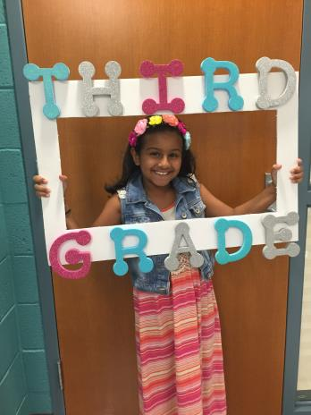
Ava

Slide 3
Houda

Slide 4
Nour

Slide 5
Mustafa

Slide 6
Muhammed S.

Slide 7
Masar

Slide 8
Elaina

Slide 9
Lamees

Slide 10
Roman

Slide 11
Louay

Slide 12
Ilianna

Slide 13
Anahid

Slide 14
Najla

Slide 15
Reda

Slide 16
Ahmed

Slide 17
Gabriel

Slide 18
Hamza

Slide 19
Mahdi

Slide 20
Ava

Slide 21
Nabrisa

Slide 22
Alexia

Slide 23
Hussein

Slide 24
Mohamed

Slide 25
Paris

Slide 26
Hashem

Slide 27
Ritsa

Slide 28
Mohamed

Slide 29
Dema

Slide 30
Adam

Slide 31
Mohammed

Slide 32
Mellak

Slide 33
Mrs. Attia

Slide 34
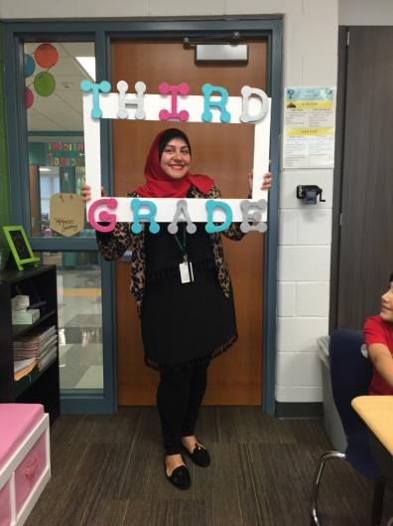
Mrs. Attia

Slide 35
Enjoying our Jitter Juice

Slide 36
It was delicious!

Slide 37
Thank you for visiting our classroom!!
Mrs. Attia’s
3rd Grade Rock Stars

