Slide 1
Imagery
language that appeals to the five senses

Slide 2
Imagery: the five senses
Sight
Sound
Smell
Taste
Touch

Slide 3
Sight
“The light glitters in her eyes.”
stuff you can see

Slide 4
Sound
“We heard rapid, high-pitched squeals.”
stuff you can hear

Slide 5
Smell
“A powdered sweetness filled the air.”
stuff you can sniff

Slide 6
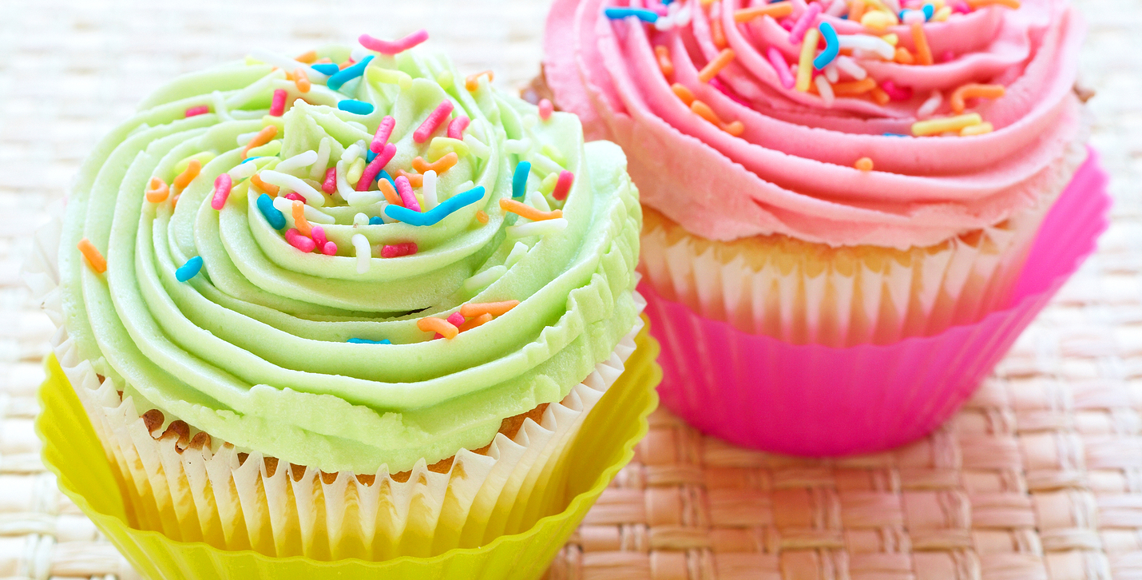
Taste
“She felt the moist crumbles melt on her tongue.”
stuff you can taste

Slide 7
Touch
“Rough, jagged stones cut into his hands.”
stuff you can feel

Slide 8
But it’s not all imagery.
Just because you can “see it in your mind” does not mean it is imagery.
*Sometimes it lacks description.
*Sometimes it is just plot.

Slide 9
Sure, you can “see” someone throwing a ball, but it is an action in the story and is not meant to give the reader a more real or vivid sense of things.
“He threw the ball.”
This is plot. Not imagery.

Slide 10
Now that’s imagery! It gives us more visual details about what the ball looked like.
“He threw the ball, which was crusty and worn.”

Slide 11
Sure, you can “hear” her sighing and saying “blah,” but it is simply action, dialog.
“‘Blah,’ she sighed.”
This is plot. Not imagery.

Slide 12
Now that’s imagery! It gives us more auditory details about what the sigh sounded like.
“‘Blah,’ she sighed, the air passing through her lips like air being let out gently from a balloon.”

Slide 13
Practice: Make the following phrases that are not imagery into imagery by adding sensory details.
He turned on the light.
She screamed.
He gave her flowers.
She ate chocolate.
He patted her back.

Slide 14
Practice: Here are some examples. How’d you do?
He turned on the soft, glowing reading light.
She screamed a harsh, guttural cry from the pit of her stomach.
He gave her flowers that smelled of an old, damp envelope.
She ate sweet, creamy, melted chocolate.
He patted her back roughly, causing tingling pins to surface under her shirt.

Slide 15
Imagery can do so much more!
Aside from appealing to your senses, imagery can be used to create mood or elicit emotions.

Slide 16
He turned on the _______ light.
soft, glowing reading
harsh, bright white
How does each light feel?

Slide 17
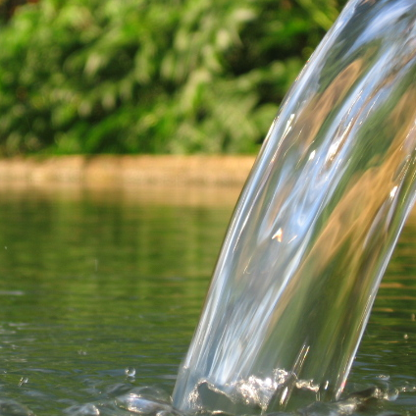
He gave her flowers that smelled like _______ .
an old, damp envelope
a fresh morning spring
How does each smell feel?

Slide 18
Practice: Add sensory details to each phrase twice: make one positive and the other negative.
He heard a voice.
She felt her shirt.
The sun shined.

Slide 19
Practice: Here are some examples. How’d you do?
He heard a voice floating on a breeze.
She felt her soft shirt caress her skin.
The sun shined golden on the clouds.
He heard a voice screech like static.
She felt her shirt scratch at her skin.
The sun shined like knives in his eyes.

Slide 20
Imagery
Language that appeals to the five senses
Sight, Sound, Smell, Taste, Touch
Language that paints a more vivid picture
More than just plot or dialog
Language that can appeal to the emotions

Slide 21
Imagery
language that appeals to the five senses

