Slide 1
Solving Proportions using…
Unit Rate
Multiplication and Division
Cross Product

Slide 2
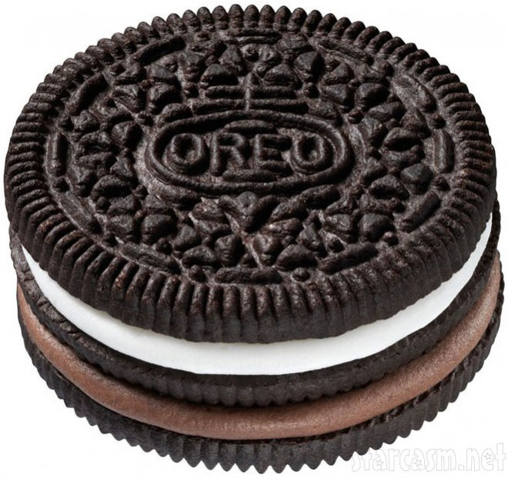
#1
A package of 32 oreos cost $2.99. How much for just one oreo?

Slide 3
#2
50 pencils sell for $2.00. How many pencils can you buy if you have $5.00?

Slide 4
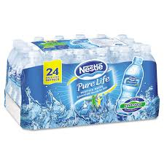
#3
A case of water costs $3.29. How much for one bottle of water?

Slide 5
#4
I purchased 2 pounds of strawberries for $2.50. How much would I pay if I purchased 7 pounds of strawberries?

Slide 6
#5
What’s the missing number in this ratio table?
2 | 6 | 10 | 14
15 | ? | 75 | 105

Slide 7
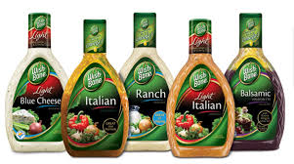
#6
A bottle of salad dressing costs $3.30. If the bottle holds 15 ounces, what is the unit rate per ounce?

Slide 8
#7
At Kroger, a box of Cheerios costs $4.39 for 26 ounces. How much is one ounce?

Slide 9
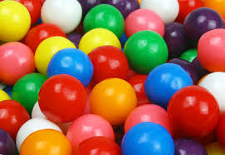
#8
15 gumballs cost $1.50. I want to buy gumballs for 35 of my favorite friends. How much will I pay for all of them?

Slide 10
#9
A cell phone package at Verizon sells 30 gigs of data for $89.00. How much does 1 gig of data cost, according to this plan?

Slide 11
#10
What’s the missing number in this ratio table?
7 | 21 | 35 | 49
10 | 30 | 50 | ?

Slide 12
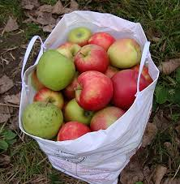
#11
Six pounds of apples costs $5.80. How much are the apples per pound?

Slide 13
#12
If 5 pieces of fruit cost $4.00, how much would 12 pieces cost?

Slide 14
#13
What’s the missing number in this ratio table?
11 | 22 | 33 | 44
9 | 18 | 27 | ?

Slide 15
#14
25 pieces of candy cost $2.75. How much would 10 pieces of candy cost?

Slide 16
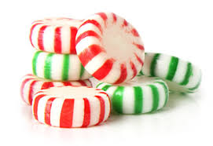
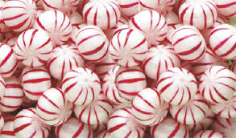
#15
At Costco, a package of mints is $12.00 for 400 mints. What is the unit rate per mint?

Slide 17
#16
Sue babysits for her neighbor. If she earned $42.00 in 3 hours, how much did she earn per hour?

Slide 18
#17
What’s the missing number in this ratio table?
5 | 15 | 25 | 35
9 | ? | 45 | 63

Slide 19
#18
If Mr. Haddad pays $14.00 for a box of 32 blowpops, what is the unit rate per blowpop?

Slide 20
#19
If 32 students used 64 pencils, how many pencils would 100 students use?

Slide 21
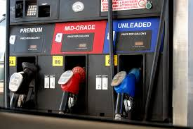
#20
Yesterday I bought 22 gallons of gas for my car. I paid $45.98. How much did I pay per gallon for the gas?

Slide 22
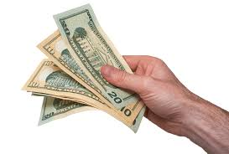
#21
A college student earns $11.00 an hour tutoring other college students. How much money will this student earn if they tutor for 17 hours in a week?

Slide 23
#22
What’s the missing number in this ratio table?
8 | 32 | 64 | 96
10 | 40 | 80 | ?

