Slide 1
Argumentative Essay
How to construct an effective argument

Slide 2
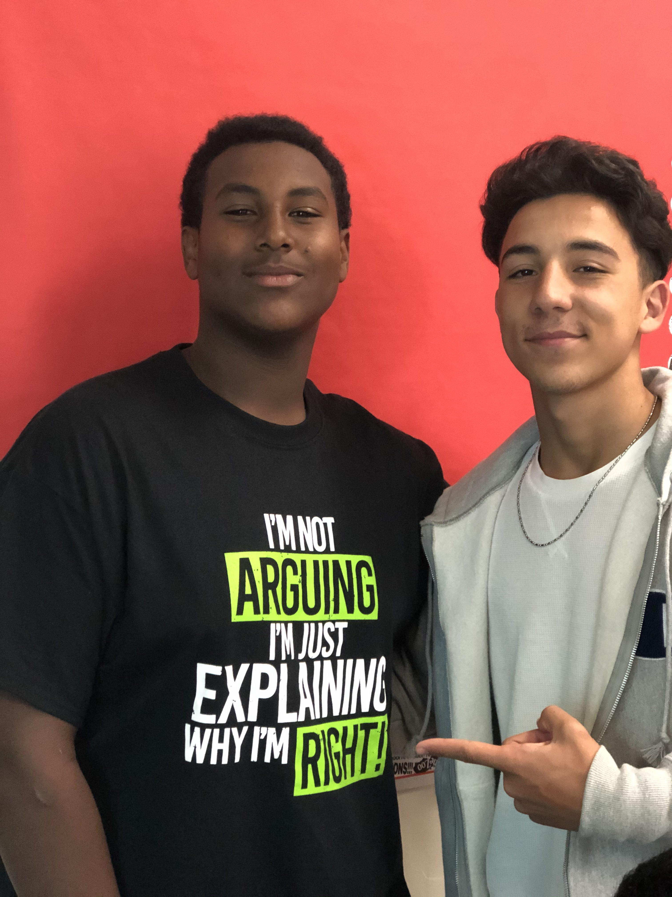
What is argument? What comes to mind when you hear the word argument?

Slide 3
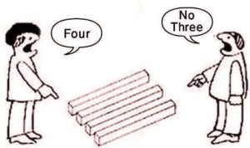
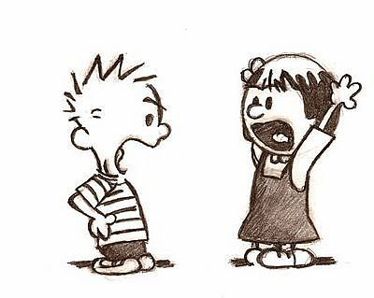
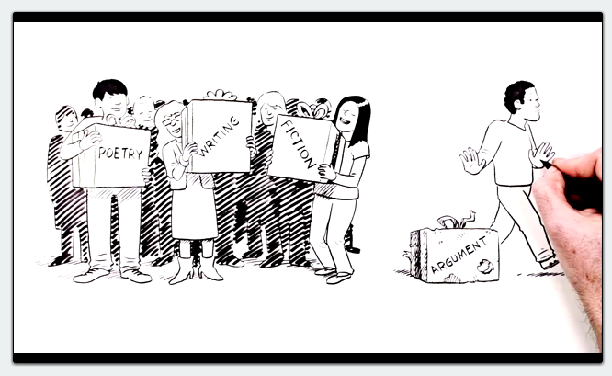
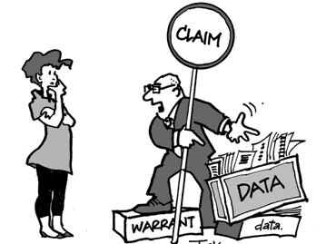
The following presentation will include information related to the argumentative essay, which asks you to develop and support a stance on an issue. In an argumentative essay, you must take a side and provide reasoning and evidence for your position.

Slide 4
The argumentative essay question can ask you to do any of the following: 1. Defend, challenge, or qualify a quotation about, or particular take on, a specific topic 2. Evaluate the pros and cons of an argument and then indicate why you find one position more persuasive than another 3. Take a position on whatever debatable statement is provided in the prompt

Slide 5
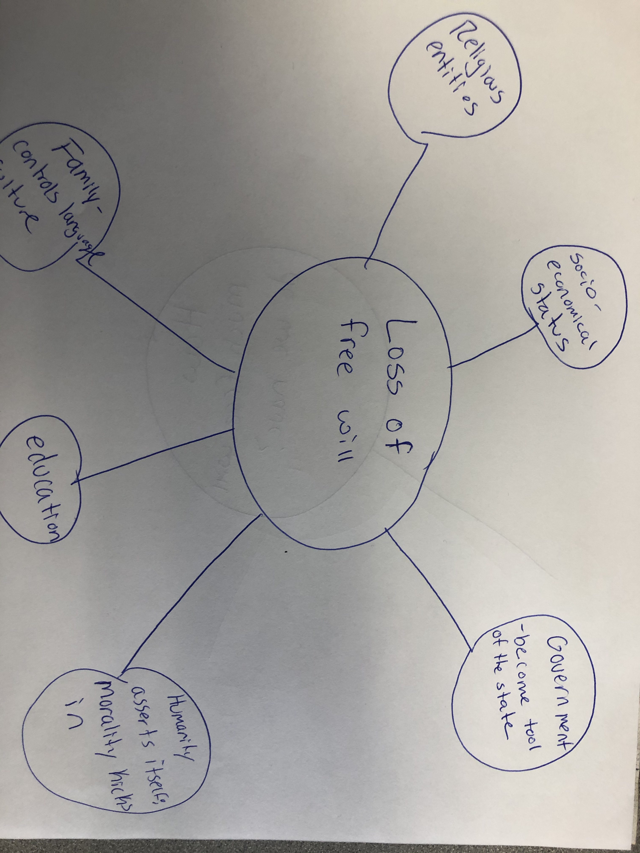
This essay does not provide any text other than the prompt. Instead, your claim is supported by your own reading, observations, and experiences. In other words, this essay’s only support is you; what you “know” is the textual support. This essay can be difficult, as the question, regardless of what it is, presupposes that you have knowledge about the topic under discussion. The more you’ve learned about the world around you, and the more opinions you have formulated about it, the better.

Slide 6
Argument Outline: I. Introduction A. Issue/Rhetorical Situation B. Your CLAIM (including exigence) II. Body Paragraph 1 A. Topic Sentence: First Reason i. Commentary-Reason for your Reason III. Body Paragraph 2 A. Topic Sentence: Second Reason i. Commentary-Reason for your Reason VI. Conclusion A. Reiterate claim B. Implications on the world, society, humanity
What does an argumentative essay look like?

Slide 7
STEP 1: Introduction A. Issue/Rhetorical Situation B. Your CLAIM (including exigence)
First establish a claim…
CLAIMS: a claim is an assertion about a controversial question (or issue question, as distinct from a question of fact) that gives rise to alternative answers and about which reasonable people might disagree. In other words it must be debatable.
The claim is the heart of your paper; it’s what keeps it ALIVE.

Slide 8
A claim is the main argument of an essay. It is arguably the single most important part of an academic paper. The complexity, effectiveness, and quality of the entire paper hinges on the claim. If your claim is too simple or obvious, the rest of the paper probably will be, too. A claim defines your paper’s goals, direction, scope, and exigence. A claim must be argumentative. When you make a claim, you are arguing for a certain interpretation or understanding of your subject. A good claim adds something meaningful to the current dialogue surrounding your topic.

Slide 9
Where does a claim go?
The main claim is always at the end of the introduction; the very last sentence. It must be one sentence that contains both the exigence and YOUR position.
What does exigence mean?
In rhetoric, exigence is an issue, problem, or situation that causes or prompts someone to write or speak. It is otherwise known as the GREATER OCCASION, but it’s bigger than that.
Exigence has to do with what prompts the author to write in the first place, a sense of urgency, a problem that requires attention right now, a need that must be met, a concept that must be understood before the audience can move to a next step.
Let’s practice…

Slide 10
Activity: Improve these claims:
1. Global warming is a bad thing.
2. Indeed, Blue Lives matter.
3, The student loan crisis is a huge problem in this country.
4. Gender inequality still exists today.

Slide 11
Improved Claims:
Climate change is the single greatest threat to life on this earth.
Climate change is the single greatest threat to life on this earth.
2. The lives of police officers on the front lines of our communities are particularly important for our society to protect.
3. The student loan crisis is on the verge of causing an economic catastrophe in the U.S.
4. Despite years of progress for women, we still have a great deal of work to do as a society until they are fully equal to men.

Slide 12
Body Paragraphs Remember to use evidence to develop your own argument. Do not forget to include examples, but also do not let them take over your essay. Support your claim drawing on all that you know about the subject: what you’ve experienced, read, or observed – generally AVOID personal anecdotes and too many pop culture/celebrity references. Your goal is to sound well read, educated, and reasoned. The order of the essay can be varied, and any rhetorical strategies can be employed, but you must make certain that your support/evidence is appropriate and effective. You may rely on facts/statistics, details, quotations, anecdotes, cause and effect, appeal to authority, etc. Remember readings, entertainment/arts, history, universal truths, government, and observations. Your support should be rational and logical, not emotional; it should be objective rather than biased. Watch for – and avoid – logical fallacies.

Slide 13
Body Paragraph 1 A. Topic Sentence: First Reason i. Commentary-Reason for your Reason

Slide 14
AP Example Introduction: The main points within this passage suggest that America is a country where a multitude of cultures, religions, and languages coexist. He suggests that our government, which was created "on the principles of society and the rights of man", is able to overcome the aforementioned differences. This assertion can easily be disproved.

Slide 15
AP Example Body Paragraph 1:
The disharmonious existence of multiple cultures and religions has been seen throughout this country's history and today. Paine acknowledges that "it would appear that the union of such a people was impracticable" and to some extent it is. While most people are able to coexist with their neighbors peacefully, it is clear that this is not always the case. After 9-11, Muslims became the target of racial violence and religious discrimination; not by the government, but by the people. Currently, and since I can remember race has been an issue in America tearing apart the country. Black Lives Matter is the most current manifestation of this injustice, but this goes back to the entity of Slavery. The Civil War is a significant example of how country was not in cordial unison, and in many ways we are still living in the shadows of that history. One hundred years post Civil War, we had the Civil Rights Movement. We are possibly on the verge of another great movement. However, if a government is to be considered "just", it has a duty to protect these citizens. This is not happening.

Slide 16
The socioeconomic utopia Paine creates is also untrue. He wrote that in a country created like America, "the poor are not oppressed, the rich are not privileged". Contrary evidence in the past few years suggests otherwise. While no person was left completely unaffected by the economic recession of 2008, the gap between the upper and lower classes was widened. The wealthy are indeed continuing to live a "privileged" lifestyle. The poorer citizens are not oppressed by the government, but by the situation that the government refuses to remedy. This depicts a flaw in the argument of Thomas Paine. If you just drive down the streets of big cities like Chicago, New York, Detroit, Las Angeles, just to name a few, it is evident from the homelessness that the poor are oppressed. Ironically enough, homelessness is illegal in many states. A homeless man or woman is not allowed to be on the streets, yet we do not have a system that authentically solves this problem. From taxes to neighborhoods to schools, the lines are clearly drawn between the poor and rich leading to oppressions and privileges.

Slide 17
Example Introduction: Nature verses nurture is a debate older than time. It is understandable why it would be. Free will is dependent on how much nature limits us. How much of our environment limits us. The reality is our free will is directly tied to both, and both limit our free will. It is detrimental to humanity to believe in the notion of free will.

Slide 18
Free will is an illusion; we think we have it but it is actually limited by institutions. We have entities like religion, family units, government laws, health care system, education and socioeconomic status all limiting me from different angles. We promote free will like it is something I actually have, but in reality I do not. Can I speed without receiving a ticket? Did I choose the language I speak? Yes, I can learn a new language, but my first language was chosen for me. Did I have a choice in writing this essay? Some may say, yes, you have the choice and deal with the consequences, but if there are consequences, then is that a choice? Be imprisoned or go to school? That’s free will? The truth of the matter is our will to make decisions is controlled and influenced by so many aspects of society, and our will to live freely is compromised and soon we will not have any choices at all. This will be dangerous to humanity. What will human life be like in a the future if we continue down this road? So much of our lives is controlled, and if we go down this road we will be in worse situation.

Slide 19
Our genetic predispositions also limit our free will. We are told we can do what we want, and be what we want, but how true is that? There have many studies done that expose how limited we are by nature. I am not born to a basketball player. Yes, I can try to train and overcome the genetics I have been given, but is that free will? It may be to an extent, but it is definitely limiting when we have inherited genes that predispose us to be a certain way.

Slide 20
Reasoning Stems
The power of____ lies in ____.
___ shows the clear benefits of ____.
___ does not change the fact that _____.
This____causes___.
This suggests_____.
By_____, _______.
If___, then_____.
The implications of_______are_______.
This is significant because_______.
This indicates_____.

Slide 21
Argumentative Prompt:
Argue, to what extent do we have a choice in our own lives? In other words, to what degree is our free will actually “free.” How much influence do the pushes and pulls of our genetic predispositions (nature) or our socially learned behavior (nurture) do we ultimately overcome or succumb to?

Slide 22
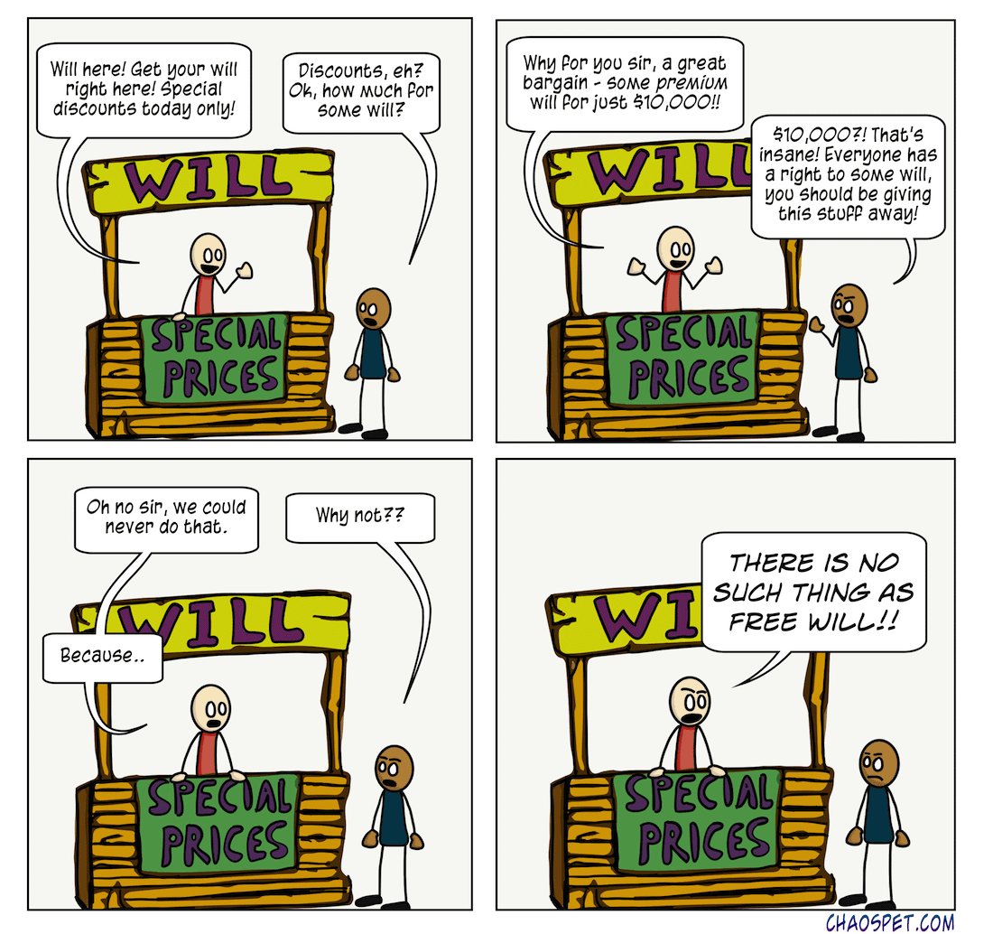

Slide 23
Sample Claims: Even though free will is limited, human beings are able to cause their own actions and they are therefore responsible for what they do. – Free will does not exist due to the variety of entities in society that govern us. – Free will exists, but as a biological brain mechanism, not as a characteristics of spiritual soul as it is traditionally believed, so it is time to reconsider the notion. – Free will exists as a characteristics of a soul, but it is as incomprehensible to science as the notion of God

