Slide 1
Read Like A Writer Routine

Slide 2
Assignment Objective:
The objective of this assignment is to learn how to read complex material; to do this, you must read like a writer. The skills gained from this assignment will help you with your reading, writing, and speaking skills in everyday life. Learning to unpack difficult reading passages will help improve PSAT/SAT scores, AP exam scores, class exam scores across all subject areas.

Slide 3
Please take 5 minutes to read the article: “Washington, April 14, 1865”
Do not annotate; do not write on it at all.
Read for understanding ☺

Slide 4
Read Like A Writer Instructions (5 Minutes)
Read and annotate the instructions
Please keep track of all questions and/or concerns that come to mind, and by the end of the presentation I will do my best to address them.

Slide 5
Instructions:
An article will be assigned routinely (weekly or biweekly); your assignment is outlined in the steps on the following page. You are to complete ALL the steps on a separate sheet of paper. The entire assignment is to be handwritten; typed assignments will never be accepted. Your assignment is to be handed in on the announced due date and you are expected to complete a quiz at the beginning of class on the day it’s due (usually a Monday). You are not allowed to use the assignment for the quiz, but you are allowed to use the article. You may want to mark notes on the article to use on the quiz. The assignment is worth _____ points summative and the quiz is 10 points formative.

Slide 6
I. Vocabulary
To practice learning the meaning of words from context, choose words from the article that you did not know previously. For each of the words:
Quote the sentence from the article (Underline the word in the sentence)
Infer or write what you think the definition is based on context. This is a prediction; you can’t be wrong
Write the context clues that help you determine the definition of the word.
Write the dictionary definition of the word
Let’s try it…

Slide 7
Vocabulary Practice: Try it with the following word
Quote the sentence from the article (Underline the word in the sentence)
“Medical aid was immediately sent for, and the wound was at first supposed to be fatal, and was announced that he could not live but half-past twelve he is still alive though in a precarious condition.”
Infer or write what you think the definition is based on context. This is a prediction; you can’t be wrong
Write the context clues that help you determine the definition of the word.
Write the dictionary definition of the word

Slide 8
Vocabulary Example
“Medical aid was immediately sent for, and the wound was at first supposed to be fatal, and was announced that he could not live but half-past twelve he is still alive though in a precarious condition.”
I think it means “not in good” condition
The context clues that helped me determine the meaning are “at first supposed to be fatal”. The author is stating he wasn’t dead, but when he used “at first” we expect there to be another part. It’s obvious that even though the President was alive, he could not have been in good condition if it was announced he was supposed to die.
Dictionary Definition: not securely held or in position; dangerously likely to fall or collapse; uncertain

Slide 9
II. Paraphrase
Paraphrase the entire article; do this by line numbers (e.g. Lines 1-5: reword, Lines 6-10: reword). This means to reword each sentence in your own words. This demonstrates your understanding of the speaker’s intended meaning. The best way to do this is to read the lines, cover it up or put it away, retell what you read, and then write it. Then reread the original lines; do your words mean the same thing as the original?
Let’s try this using the following…

Slide 10
Paraphrase Example
Article: “Washington, April 14, 1865” published in New York Herald, April 15, 1865.
Lines 4-9 - “Washington was thrown into an intense excitement a few minutes before eleven o’ clock this evening, by the announcement that the President and Secretary Seward had been assassinated and were dead.”
Paraphrase-After news spread that both the President and the Secretary of State were murdered, Washington was in a frenzy between 10pm-11pm

Slide 11
III. Identify Central Argument/Main Idea
First identify the lines where the speaker states the central argument (claim or main idea) of the article (e.g. Lines 11-13 is where the author states his/her central argument/main idea). In other words what is the author’s point? Why is the author writing this article?
Then write it in your own words demonstrating your understanding of the author’s central argument or main idea.
Let’s try it…find the author’s central argument

Slide 12
Identify Central Argument/Main Idea Example
Lines 15-17: “Some time has elapsed before authentic data could be ascertained in regard to the affair”
this is the most important part….writing it in your own words
The author’s intention is to report real details of the event and update the American people of President Lincoln’s condition. The author spent the introduction elaborating that many exaggerated stories have been going around so he wants to clear up the confusion.

Slide 13
IV. Evidence Supporting the Central Argument/Main Idea
Identify at least 2 pieces of evidence that support the speaker’s central argument or main idea; there may be more than 2. In other words, how does the author make his/her argument or main idea stronger? Basically, what mini claims are provided to support the overall claim?
Connect how the evidence support the author’s overall claim/main idea.
Let’s try it…

Slide 14
Evidence Supporting the Central Argument/Main Idea Example
Evidence 1
Lines 21-26: “At the close of the third act a person entered the box occupied by the President, and shot Mr. Lincoln in the head. The shot entered the back of his head, and came out the temple.”
Since the author’s intention is to report “authentic data” he begins with how and where the President was shot.
Evidence 2
Lines 27-34: The assassin then jumped from the box upon the stage and ran across to the other side, exhibiting a dagger in his hand, flourishing it in a tragical manner, shouting the same words repeated by the desperado at Mr. Seward’s house adding to it, ‘The South is avenged,’ and then escaped…”
As the author shares more information of the event, it gets more detailed and graphic. The author narrates the event as if he witnessed it. With such detail of the assassin’s actions, right down to what he said, it convinces the audience that his report is valid.

Slide 15
V. Tone
Tone is a reflection of the author’s attitude toward his subject. He/she might be enthusiastic, cynical, nostalgic, humorous, sentimental, satiric, didactic, etc. An author’s tone may change throughout the article; however, for this exercise look for the overall tone and select one adjective (tone word) and briefly discuss why it best describes it. Then, provide evidence to support.
Tone:
Support: “ “ (quote examples of 3 “words and/or phrases which set the tone)
Let’s try it…

Slide 16
Tone Example
Tone: Objective/Neutral-the author merely reports the details of the event without projecting his emotions on the matter. At times it felt like a police report.
Support:
”shot entered the back of his head, and came out the temple.”
“…dropped his pistol and hat”
“Mr. Lincoln fell forward from his seat”
“was announced he could not live”

Slide 17
VI. Inference
To infer is to conclude by reasoning from premises or evidence; to predict or surmise. If you say, “I’m going to fail this test,” I can infer that (a) You don’t understand the material; (b) You didn’t study; (c) You think I give unfair tests; (d) You just got in a fight with your best friend and don’t care about the grammar test; (e) Etc.
Fact: “ “ (Quote a fact from the article)
Inference: (Draw an inference from the fact. Be careful that you are not just paraphrasing the fact)
Let’s try it with this fact…

Slide 18
Inference Example
Fact- “At the close of the third act a person entered the box occupied by the President, and shot Mr. Lincoln in the head.”
Inferences-
American Presidents did not have good security at the time
America was still not mended post Civil War
The South was still bitter
The shooter wanted to make sure Lincoln dies by aiming for the head at close range

Slide 19
VII. Analysis (Author’s Moves)
When engaging in an academic reading, we must make note of the most significant “moves” the author makes so that we can better understand his/her message and, ultimately, so that we may make those moves in our own writing. Good readers know that everything the writer includes is a choice!
Argumentative Texts: Rhetorical Analysis. Rhetoric is persuasive speech and writing, and rhetorical strategies are the most noticeable or obvious rhetorical techniques a writer employs.
Fiction/Literature: Literary Devices. When reading literature, look for the strategies your teacher tells you are important. When in doubt, just look for DIDLS, which stands for diction (word choice), imagery, details, language, and structure.

Slide 20
VII. Continued…
How to write about the author’s moves:
Find two examples and infer the effect each has on the passage. The effect is referred to as your reasoning/commentary, and it demonstrates your ability to infer.
Identify (label) and Quote: “ “ (Examples of strategies: anecdotes, statistics/research, examples of word choice or diction, syntax, imagery etc)
Effect: Infer the effect or impact the move has on the audience or how much stronger the argument is because of it (this is the reasoning/commentary). Again, this is another way to practice inference.

Slide 21
Rhetorical Analysis (Rhetorical Strategies) Example
Strategy 1- Chronological order: the author organizes the details in the order that they occurred and walks the audience through the details of the event and does not reveal the actual condition of President Lincoln until the very end.
Effect/Reasoning/Commentary- Organizing the details in chronological order helps the audience follow along easily and even though it’s a tragic event, people are more at ease when they are well informed. With the chaos the author describes at the beginning of the article the audience would appreciate the delivery of the event’s details in this manner. The author accomplishes his purpose by clearing the confusion of all the rumors and delivering trustworthy details.

Slide 22
Rhetorical Analysis (Rhetorical Strategies) Example
Strategy 2- Syntax-in lines 11-15 the author employs parallelism. Parallelism is the use of components in a sentence that are grammatically the same; or similar in their construction, sound, meaning, or meter.
“Men, women, and children, old and young, rushed to and fro, and the rumors were magnified until we had nearly every member of the Cabinet killed.”
Effect/Reasoning/Commentary- This particular use of syntax creates a compelling and rhythmic moment in the article, as well as memorable. Parallel structures assist the comprehension of the reader and provide a memorable rhythm to the writing. This helps the author both gain the attention and trust of the reader, because the readers are living in the intense state the author is describing. The description also sets up the reader to appreciate the calmness and order of the rest of the article.

Slide 23
Remember, almost everything is rhetoric. Rhetoric is all around us; we cannot escape it. Our duty is to analyze rhetoric, unpack it, read between the lines, GET INTO THE WRITER’S MIND.

Slide 24
How Can We Use This Assignment As A Precursor for Writing In The Future?
Rhetorical Analysis
Argumentative:
Add a Step 8…with the opinion pieces the students can take a position on the issue.
More on this in a future PD

Slide 25
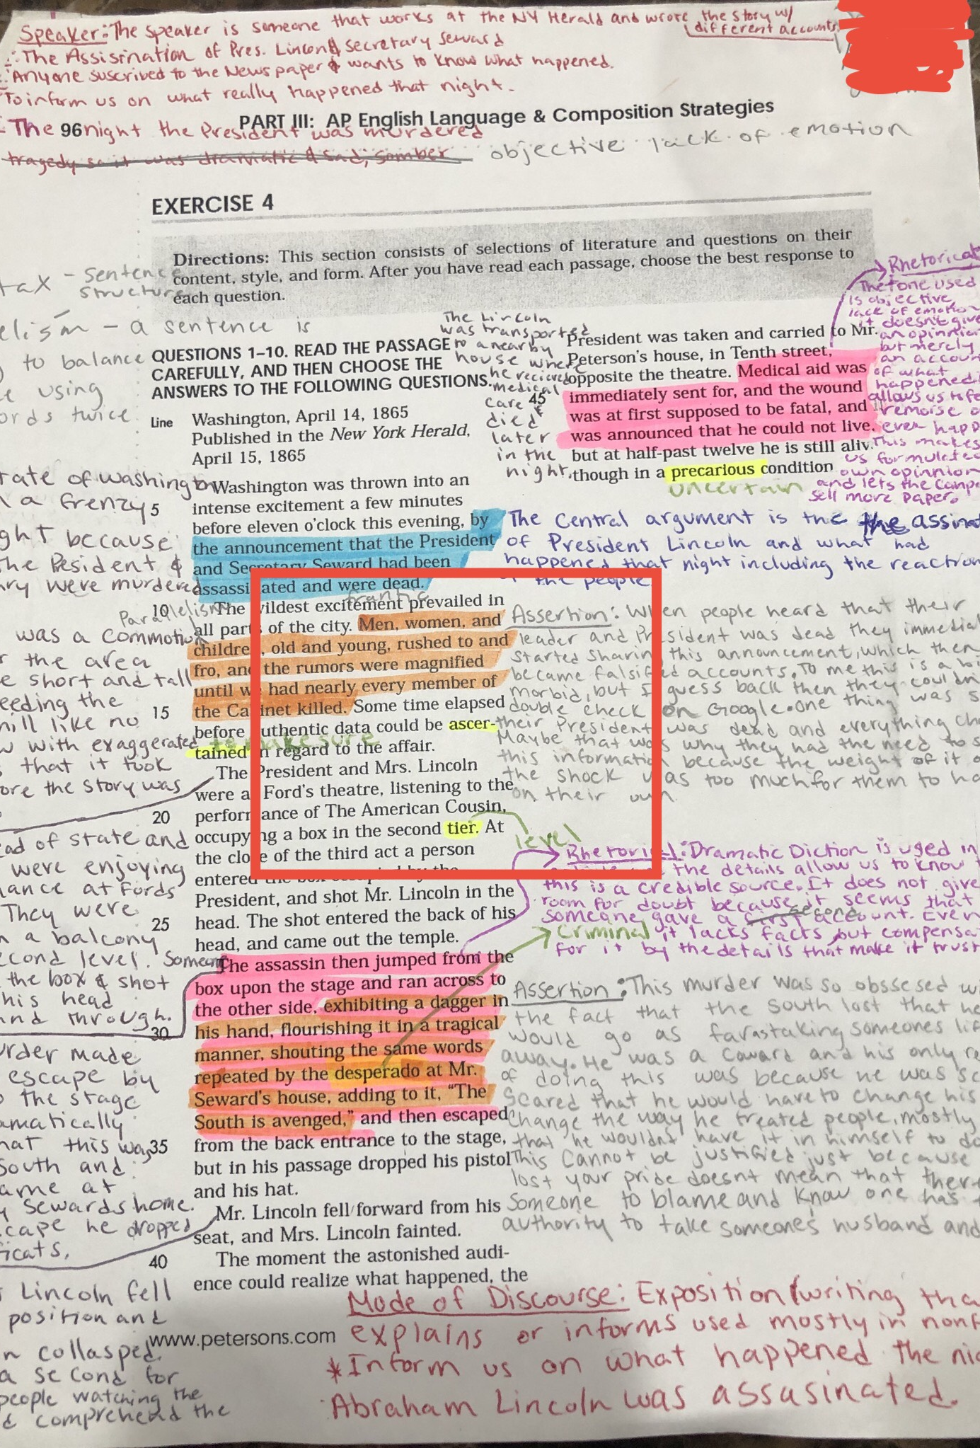
Student’s Annotations

Slide 26
Work Cited
“Washington, April 14, 1865” published in New York Herald, April 15, 1865.

