Slide 1
Graph Analysis:
Strategy and Practice

Slide 2
Strategies for Approaching the SAT Graph Analysis Questions
5 Questions on the Reading Section will be graph interpretation.
SAT now has quantitative analysis as a part not jut of the math, but of the entire Evidence Based Reading and Writing Section. These questions are not just based on physical sciences, but social sciences, finances, computer science, and anything else that involves statistics and numbers as evidence.
You will not need background knowledge to answer these questions, but taking rigorous courses in the sciences and social sciences will help you do your best.
This presentation involves 5 tips for approaching the SAT graph analysis questions.
32 Practice questions provided separately.
Let’s get started...

Slide 3
Tip 1: Use only the evidence provided
Since you are not required to use background knowledge on questions, do not allow yourself to pick anything that is not directly supported by the information in the graph. Even if a choice may be true based on your memory, do not choose it unless there is evidence right in front of you.

Slide 4
Tip 2: Be certain that your answer is 100% correct
As in the SAT as a whole, there simply will not be partially right answers. If an answer is mostly correct but has some small part incorrect, throw it out and consider the other possibilities.

Slide 5
Tip 3: Carefully consider the graph labels and axes
The information presented depends greatly on the starting points and scales on the axes. Take the time to be sure you know exactly what is being presented--graph labels and descriptions are essential to doing this.

Slide 6
Tip 4: Don’t jump to your answer
Since the questions are well-crafted and the answers are quite persuasive, take the time necessary to break the questions down. The SAT is not a rapid recall test that you must finish quickly--it is a critical thinking test that demands patience and care.

Slide 7
Tip 5: Refer back to the text when necessary
Many of the graph analysis questions will ask you to connect information in the graph to information in the text. Be aware that you will often need to go back and forth between the text and the graph.

Slide 8
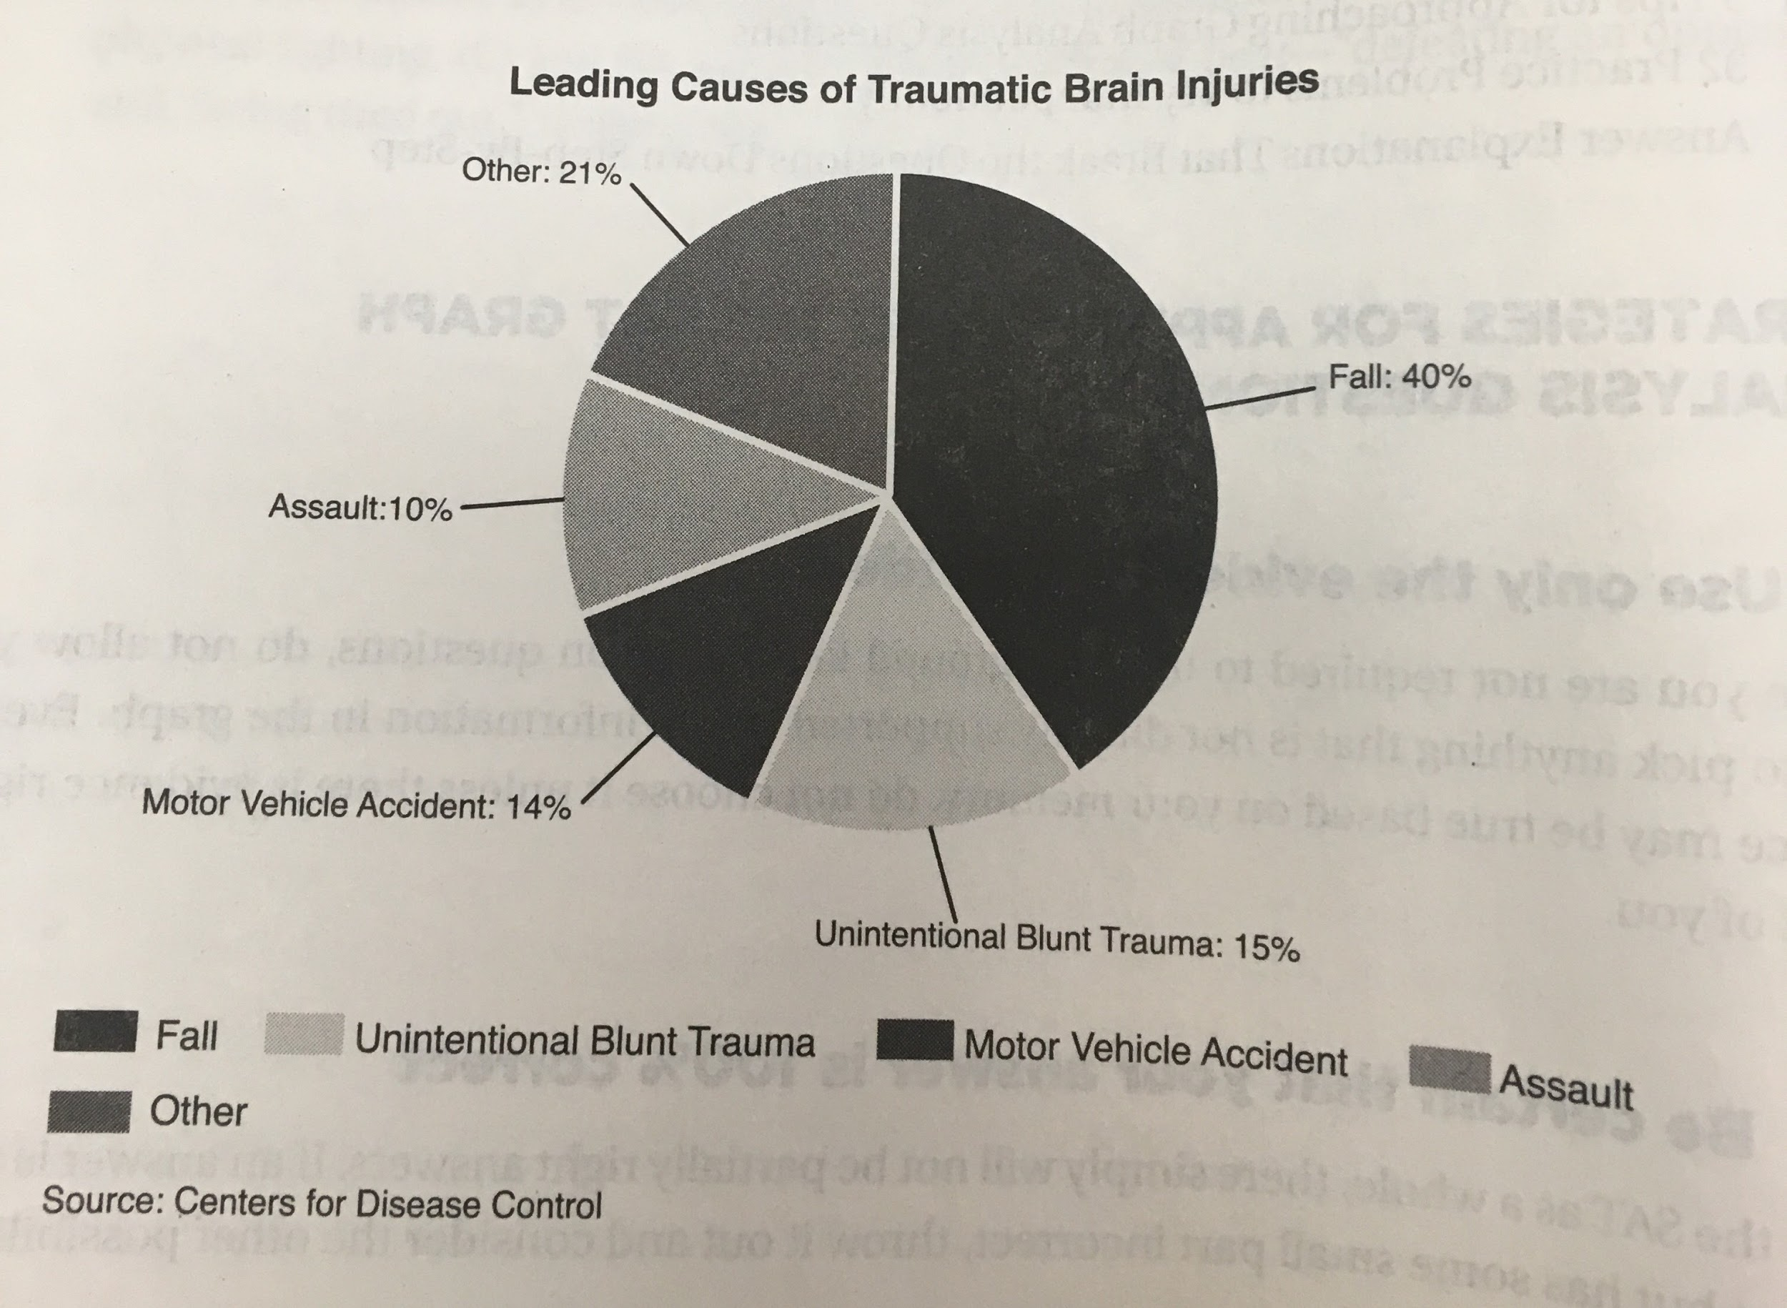
Practice:
Based on the evidence in the graph, which of the following is true?
(A) People are four times as likely to be involved in a fall than assaulted.
(B) Increased seat belt use would decrease the number of traumatic brain injuries from motor vehicle accidents.
(C) 21% of the causes of traumatic brain injury are unknown
(D) “Other” and “Assault” account for approximately one-third of traumatic brain injuries.

Slide 9
Three of the answer choices make assumptions. Can you identify which ones?

Slide 10
Answers Explained
A, B, and C all make assumptions. While “falls” account for four times the amount of brain injuries than “assault” that doesn't necessarily mean they happen four times as often.
Likewise (B) introduces external factors like seat belt use that we cannot provide evidence for.
And just because they are labeled “Other” it does not mean the causes of brain injuries are unknown.
(D)-CORRECT ANSWER
(D) is the only definite choice based on the graph; together the two categories make up 31% or about one-third of traumatic brain injuries.

Slide 11
Practice:
2. According to the graph, 15 out of 100 traumatic brain injuries are caused by
(A) motor vehicle accidents
(B) unintentional blunt trauma
(C) assault
(D) falls

Slide 12
Answers Explained
15 out 100 can be rewritten as 15/100 or 15%.
Therefore (B) is the correct answer, because “unintentional blunt trauma” is 15% of the chart.

Slide 13
Independent Practice
Now, complete the rest of the exercise on your own. 30 Questions

Slide 14
Work Cited
Stewart M.ED, Brain W. Barron's Reading Workbook for NEW SAT. Barron's Educational Series, 2017, pp. 77-90.

