Slide 1
M-Step Transition: Spring 2015
Your Pathway to Success

Slide 2
Goal for Spring 2015 Testing
All Michigan students will transition to the new M-STEP assessment with a positive experience
Most schools testing online
Schools get used to scheduling for online testing
Online testing provides opportunity for more rapid feedback
Move from fall testing to spring testing
Now students will be tested on content learned during the current school year as opposed to the previous school year

Slide 3
What will happen in spring 2015?
ELA: tested at each grades 3-8 and 11
Mathematics: tested at each grades 3-8 and 11
Science: tested at grades 4, 7 and 11
Social studies: tested at grades 5, 8 and 11
College Entrance test (required by law)—ACT in grade 11
Work Skills assessment (required by law)—WorkKeys in Grade 11
Please see the spring 2015 Testing Schedule
for more information
http://www.michigan.gov/documents/mde/Spring_2015_Testing_Schedule_Update_464310_7.pdf

Slide 4
Accountability Implications?
It is the intent of the MDE not to use the results of the 2015 M-Step assessment to make high-stakes accountability determinations.
Data provided to schools and districts for informational purposes
No Priority, Focus or Reward labels for schools

Slide 5
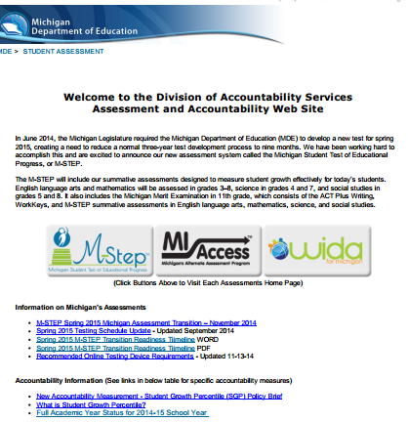
Important One-Stop Shop MDE Assessment & Accountability Web Page
MDE Assessment & Accountability Web Page
http://www.mi.gov/baa
Example:
M-STEP Transition Readiness
Timeline http://www.michigan.gov/documents/mde/Spring_2015_Transition_Readiness_Timeline_479081_7.pdf
Provides you with step-by-step information on what you should be doing to get ready for spring testing

Slide 6
Contact Us!
Phone: 1-877-560-8378
Email:
Assessment: baa@michigan.gov
Accountability: mde-accountability@michigan.gov

