Slide 1
Geer Park Elementary Parent Meeting Fall 2017
Mrs. Srour, Principal
Mrs. Abu-Rus
Ms. Alshafey - Resource Teacher
Mrs. Timpf - IC
Notes:
Sue - Welcome and Sign in

Slide 2
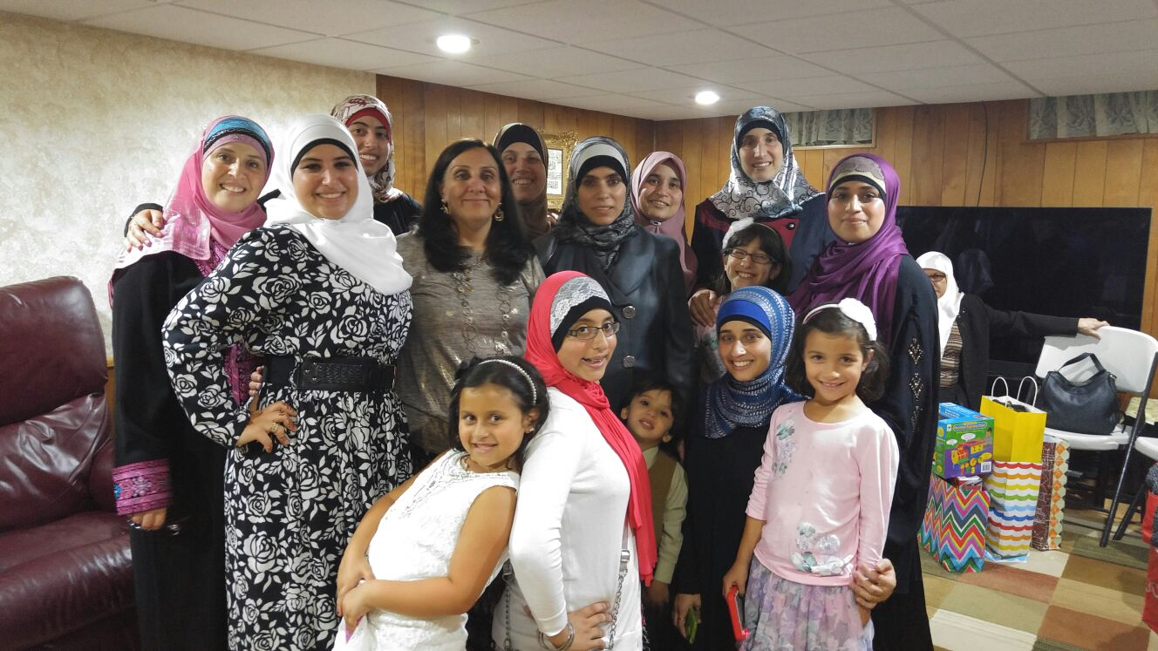
Welcome
Notes:
Talk a little about me.

Slide 3
2nd/3rd Grade
This is an exciting opportunity for all of us!
CCSS will be focused on in both grades.
Often students will learn as a whole group. This includes reading, writing and much of science.
Social Studies, math and spelling will usually be taught separately to each grade level.
Notes:
14 second graders
12 third graders
However at times 2nd graders will be invited to 3rd grade lessons.

Slide 4
Expectations
Respect others
Try your best
Participate
Be responsible
Come to school on time! The bell rings at 8:35 instruction begins promptly at 8:40.
Pick up students on time
Notes:
As the weather is changing, please make sure to be on time. It isn’t fair to students to stand in cold and wait.

Slide 5
Classroom Blogs and Remind App
My blog can be found at the site below or go to the Geer Park website and click on my name.
http://iblog.dearbornschools.org/aburuss/
Sign up for important updates on remind. Follow the handout for information.
Notes:
Encourage parents to sign up/ give handout
Conferences / phone calls

Slide 6
Each week students will have a total of 15 words to study. Ten of these words follow a spelling pattern. Another 5 are content words.
They will be tested on 20 words on Friday, 5 of them will be new words that follow the pattern.
Notes:
Sue - hot and cold words

Slide 7
Math-What to Expect
2nd Grade:
Telling time to five minute increments
Double digit addition and subtraction
Measurement
Solving word problems (by the end of the year solving multi-step)
Construct simple charts and graphs
Identify shapes
Explain math reasoning orally and in writing
3rd Grade:
Telling time to the minute
Double digit addition and subtraction
Measurement of area and perimeter
Fractions
Multiplication
Division
Attributes of plane figures
Multiple step story problems will be the main focus this year.
Explain math reasoning orally and in writing

Slide 8
Reading
Students read and write independently during Daily 5. We work on building our reading and writing stamina. They must work diligently but independently for up to an hour a day while I meet with groups.
Students will have a small group with me anywhere from 2-5 days a week, depending on how they are progressing.
Students need to read at home for at least 15 minutes daily. This should be uninterrupted, quiet time.
Talk to your child about what they are reading. Have them retell what they read.

Slide 9
Writing - What to Expect
Both Grades: We will focus on the 6 traits of writing to improve our skills in three areas. Narrative,Opinion,Informational
Traits
Voice
Organization
Ideas
Conventions
Expanded Word Choice
Sentence Fluency
Notes:
Look at Voices Board

Slide 10
Social Studies - What to Expect
2nd Grade : Communities and the role of citizens
3rd Grade: Michigan - geography, history, growth, economy and government

Slide 11
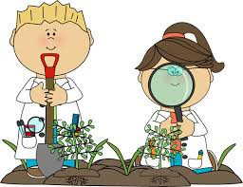
Science - What to Expect
Both Groups: Stem and PBL - together as much as possible.
2nd Grade :
Structure and Properties of Matter
History of the Earth
Plant and Animal Ecosystems
3rd Grade:
Forces and Interactions
Weather and Climate
Interdependent Relationships in Ecosystems
Life cycles and Traits

Slide 12
Reading
Students must read for 15-20 minutes each night.
Written response journals
Article a week - must be signed by parents
2. Math
Homework - 3-4 nights a week.
3. Content areas
Occasional homework
Occasional at home projects to complete
Parents can go over notes with students frequently to ensure understandings
4. Spelling words
*Homework should not be more than 30 minutes daily.
Notes:
Spelling - will be written in their planners on Monday. These words will also be on my blog in case you need them. Students must complete a different homework assignment each night Monday-Thursday in their spelling notebook. The test will be given on Friday.

Slide 13
Study Skills
This year, the math, science, and social studies content will be in depth and new for some second graders and most third graders.
This means that students will be asked to study for many quizzes, and tests.The word “STUDY” in the planner should be taken seriously
It is important for students to think critically, not just memorize facts.
You can help your child by making index cards, discussing what they learned, and giving them practice quizzes and tests

Slide 14
Make it a habit to take your child to the Dearborn Public Library.
Set the example to your children to read and love reading.
Much of our homework this year will be computer based. They have computers at the library if you do not have one.
Notes:
article a day

Slide 15
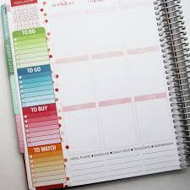
Planners and Parent Folders
All students have a planner. The students circle their behavior in the planner. They also write down the homework each day.
If a student does not remain on green, the teacher circles the color they were on with her initials.
Please check your child’s planner each day and sign it when they have completed their work.
Parent folders need to come back to school daily. Look in here for notes from our classroom or school.
Notes:
Make sure you see the work and discuss it with your children.

Slide 16
Behavior Rewards and Consequences
Students can earn punches at the end of each day for exemplary behavior. These can be traded for prizes and classroom rewards.
Each month, students who show responsibility and exemplary behavior all month will be rewarded with a 3rd Grade Reward party or incentive
Students who misbehave consistently, will have a loss of privilege and if the behavior continues, they will have a detention time.
Notes:
You will be contacted if detention occurs. Also look for notes in the parent folders. I will send notes when there are minor issues. I will call if they begin to occur frequently.

Slide 17
Snack and Lunch
Snack - A fruit or vegetable only please.
Lunch is from 12:00-12:30
Students will be going outside for lunch recess most days. They need to dress for the weather.
Notes:
coats, hats, gloves, boots
healthy choices

Slide 18
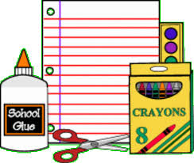
What We Need
Student Supplies
Backpack
Headphones (These will be kept at school.)
Pencils
Donations
Tissues
Clorox wipes
Copy paper
Hand soap and sanitizer.
Notes:
Full list in pamphlet
Tissues, tissues, tissues

Slide 19
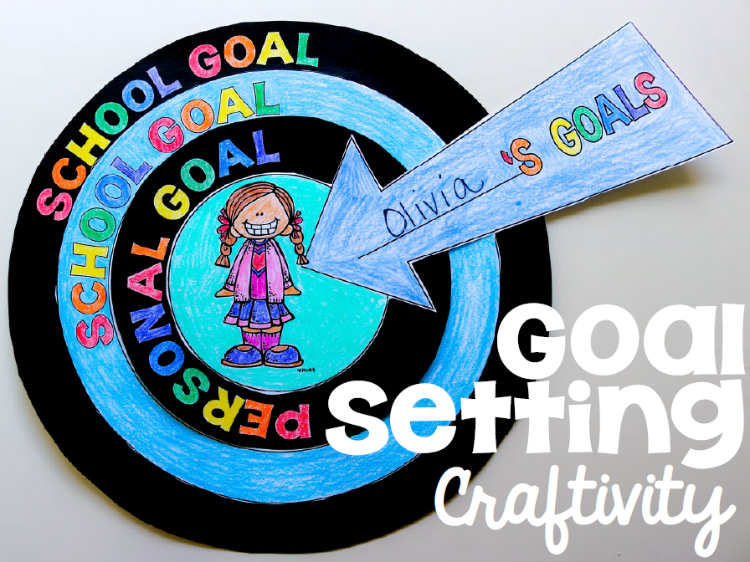
My Learning Plan
We will be meeting with students to set their goals for the year. They will set an academic and personal goal for themselves.
This will be posted on our board and monitored and changed.
In October, there will be an informational parent meeting to discuss the student data.

Slide 20
How You Can Help with Goals
Ask your child:
What is your reading strategy?
What is your writing strategy?
What is your academic goal?
What is your personal goal?
Notes:
By the end of September they should all be able to articulate this to you.

Slide 21
Questions?
Notes:
All of us

